Slide 1
Practical Messaging
A 101 guide to messaging
Ian Cooper
X and Hachyderm: ICooper

Slide 2
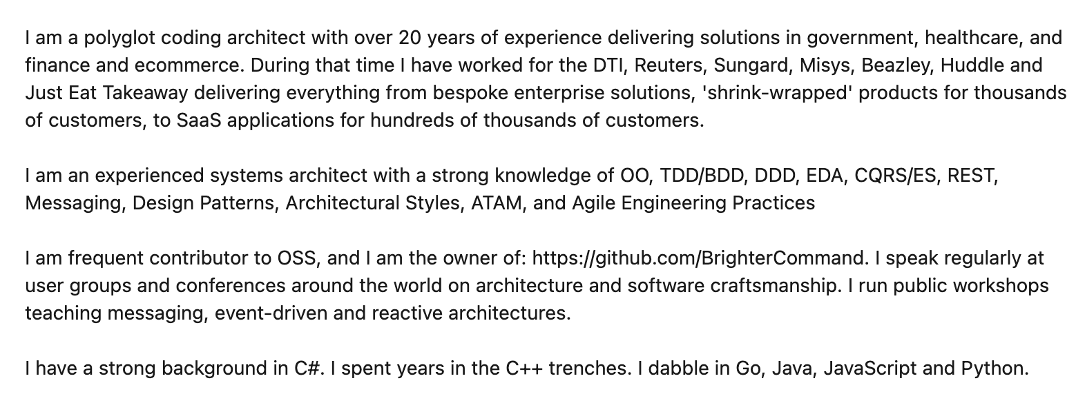
Who are you?
www.linkedin.com/in/ian-cooper-2b059b

Slide 3
Day One Messaging
Distribution
Integration Styles
Messaging Patterns
Queues and Streams
Managing Asynchronous Architectures

Slide 4
Day Two Conversations
Conversation Patterns
Activity and Correlation
Repair and Clarification
Reliable Messaging
Fat and Skinny
Conversations
Reactive Architectures
Message Passing
Paper Based Flows
Flow Based Programming
Next Steps

Slide 5
Day Two

Slide 6
Conversation Patterns

Slide 7
Messaging Participants
A message has a header (metadata) and a body (data)
An application acts as either a requestor or provider
1.1 request()
:requestor
:provider
Prefer Requestor and Provider better than Producer/Consumer for conversation patterns because they indicate role.
A message is sent over a channel which is a virtual pipe i.e. topic, routing key
A channel is unidirectional (one way)
Notes:
The problem with using producer and consumer is that the consumer of the message might be the one exposing operations: i.e. receiving a command, or the producer of the API might be the one exposing operations i.e. sending a notification. By thinking instead about requestor and producer we make the role clearer => are you providing the API or using it.

Slide 8
Messaging Participants
Requestor: Registers a store and optimizes for a fast lookup on key search terms
Message indicating new store details
1.1 changedstore()
: Search
: Store Information
Provider:
Manages stores for our ecommerce site

Slide 9
In-Only (Fire and Forget)
Typically we call this fire-and-forget.
Under a In-Only pattern the requestor sends a request to the provider, but does not seek an acknowledgment of completion of the requested operation
1.1 request()
:requestor
:provider

Slide 10
In-Only (Fire and Forget)
Requestor: Has a paid for basket it wants to turn into an order
Typically fire and forget is used where we are finished with our part in a flow, and transferring control. We need no response as we are done..
1.1 place order()
:cashier
:order placement
Provider:
Raises an Order

Slide 11
Out-Only (Notification)
Under an Out-Only pattern the requestor subscribes to the provider, and an operation is triggered by receipt of a message but it does not acknowledge the message to the provider.
Typically we call this a notification.
1.1 notification()
:requestor
:provider

Slide 12
Out-Only (Publish-Subscribe)
Registers a store and optimizes for a fast lookup on key search terms
Notification indicating new store details
:Search
1.1 changedstore()
Registers all factors for determining if a store is open for business
:Store Information
Manages stores for our ecommerce site
:Availability
Out-Only is the Publish-Subscribe pattern; a producer is not aware of its consumers; the notification has loose coupling
:Pick-Up Locations
Registers where couriers may need to pick up and restrictions

Slide 13
In-Out (Request-Reaction)
Under an In-Out pattern the provider receives a request from the requestor on one channel, and returns a response from the operation triggered by that message on a separate channel.
1.1 request()
:requestor
:provider
1.2 reaction()
When using an In-Out pattern the provider sets a correlation id (conversation id) in the header of the request and the provider returns that id in the header of the response so that we can correlate replies sent over a separate channel.

Slide 14
Request-Reaction (Command-Acknowledgement)
Command: asking checkout for the operation to price a basket
Operation: Takes payment for the agreed amount and turns a basket into an order
Manages items for purchase by a customer of our ecommerce site
1.1 checkout()
:Basket
:Cashier
1.2 successfulpayment()
In-Out can support the Request-Response or Command-Acknowledgement pattern; a requestor triggers an operation on the provider and gets a response
Response: indicating the basket has been paid for
Notes:
it has behavioural (or control) coupling

Slide 15
In-Out (Query-Result)
Operation: Determines the delivery fee based on store and items in the basket
Manages items for purchase by a customer of our ecommerce site
Query asking for delivery fees for this basket
1.1 getdeliveryfees()
:Basket
:Delivery
1.2 deliverfee()
In-Out can support the Query-Result pattern; a requestor triggers a query on the provider and gets a result
Result indicating the fee for the current state of the basket
Notes:
it has behavioural (or control) coupling

Slide 16
In-Out (Subscribe-Notify)
Operation: Manages a list of subscribers
The requestor wants to subscribe to notifications
Subscription request
1.1 subscribe()
:requestor
:provider
1.2 confirm()
Query (optional) optionally we ask the requestor to confirm (note role switch!)
Start receiving Notifications
1.3 confirmed()
1.1 notification()
1.1 stop()
In-Out coupled with Out-Only can support a Subscribe-Notify pattern; a requestor requests to subscribe to a provider (start/stop)
Stop receiving Notifications
Notes:
it has behavioural (or control) coupling

Slide 17
Blocking In-Out (Request-Reply)
The requestor provides a unique Reply To channel (in the request message header/metadata) and the provider uses that channel for the response, allowing the sender to look up the suspended workflow. A correlation id is thus not required
In order to resume, we need a way to identify the suspended workflow.
1.1 request()
:requestor
:provider
1.2 reaction()
The requestor may block on the Reply To channel whilst awaiting the reply.

Slide 18
Out-In (Solicit-Response)
Under an Out-In pattern a provider solicits a response from a subscriber, and await a confirmation
1.1 solicit()
:requestor
:provider
1.2 response()
Under an Out-In pattern the subscriber confirms receipt of the provider’s solicitation

Slide 19
Out-In (Solicit-Response)
Query to see if a courier is available to receive orders for delivery; usually Delivery service will follow with notifications of available work.
Delivery service assigns delivery request to drivers
1.1 solicit()
:Courier
:Delivery
1.2 ready()
Courier offers jobs depending on location and busyness

Slide 20
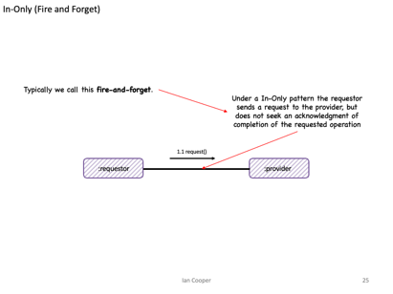
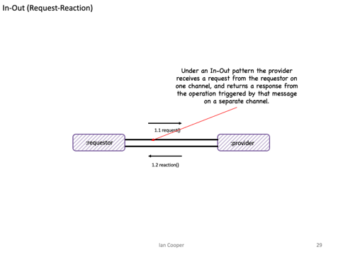
In-Only (fire and forget)
Messaging
Has Intent
Request An Answer (Query)
Transfer of Control
(Command)
Transfer of Value
Part of a Workflow
Part of a Conversation
In-Out (request-reaction)
Concerned with the Future

Slide 21
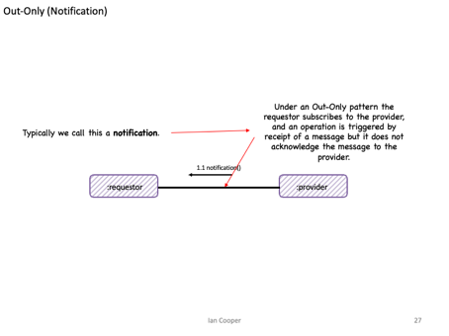
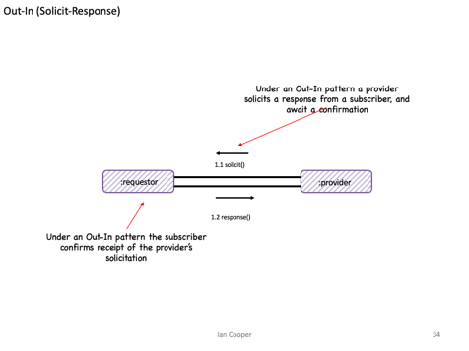
Out-Only (notification)
Eventing
Provides Facts
Things you Report On
No Expectations
Out-In (solicit-response)
History
Context
Concerned with the Past

Slide 22
Activity AND Resources
How do we manage workflows in requestors and providers

Slide 23
In-Only (Fire and Forget)
1.1 request()
:requestor
:provider
Because we are fire-and-forget there is no need to maintain state to correlate with a response; we don’t expect a response

Slide 24
Out-Only (Notification)
1.1 notification()
:requestor
:provider
Because we only notify there is no need to maintain state to correlate with a response; we don’t expect an acknowledgement

Slide 25
In-Out (Request-Reaction)
Because we expect a response to our request we may need to save state which we then correlate with the request
We may resume a workflow that we suspended, whilst we were waiting for a response
1.1 request()
:requestor
:provider
1.2 reaction()

Slide 26
In-Out (Request-Reaction) Correlation Id
The requestor adds a Correlation Id (in the request message header/metadata) and the provider returns that in the response, allowing the sender to look up the suspended workflow
In order to resume, we need a way to identify the suspended workflow.
1.1 request()
:requestor
:provider
1.2 reaction()

Slide 27
In-Out (Request-Reaction)
Because the flow is asynchronous, the requestor enters a waiting for response state – as it cannot complete its own operation until it gets the response.
The provider can remain stateless as it only needs to return a response to the requestor
:requestor
:provider
1.1 request()
Waiting for Response
1.2 reaction()
The requestor must be STATEFUL

Slide 28
In-Out (Request-Reaction) Message As Engine of Application State
The requestor can remain stateless by including the state of the conversation within the message it sends
The provider returns the state of the conversation, adjusted for its operation results
:requestor
1.1 request()
:consumer
1.2 reaction()
The requestor does not need to be STATEFUL, as it just obtains the state of the conversation from the message
N.B. in HTTP this idea becomes HATEOAS

Slide 29
In-Out (Request-Reaction) Activity and Resources
:cashier
Activity and Resources are the data and code that runs in response to receiving a message.
1.2*: get pricing details()
:pricer
Waiting for Response
1.3*: item price()
An activity also stores the state associated with the activity – what did we do in our last turn? It is keyed by a Correlation Id or Reply To channel.
1.4*: take payment()
:payment provider
An activity also knows the messages that is has sent and received, so it can be reconstructed.
Waiting for Response
1.5*: payment taken()
Activity. Data and computation used to track the work, or part of the work, for a single collaboration.
Resources. Code and data used to manage shared items coordinated across multiple activities such as widgets in inventory or space on a truck needed for a shipment.
– Path Helland, Autonomous Computing
Notes:
“To track relationships and the messages received, each entity within the scale-agnostic application must somehow remember state information about its partners. It must capture this state on a partner-by-partner basis. Let's name this state an activity. See figure 6. Each entity may have many activities if it interacts with many other entities. Activities track the interactions with each partner.”

Slide 30
In-Out (Request-Reaction) Activity and Resources
:cashier
:payment provider
An activity is the code that runs in response to sending a message.
1.4*: take payment()
Waiting for Response
An activity may store state associated with the activity – but also may be stateless (Message as the Engine of State.)
1.5*: payment taken()
Each activity also knows the messages that is has sent and received, so the conversation can be reconstructed.
Waiting for Response
Activity. Data and computation used to track the work, or part of the work, for a single collaboration.
Resources. Code and data used to manage shared items coordinated across multiple activities such as widgets in inventory or space on a truck needed for a shipment.
– Path Helland, Autonomous Computing

Slide 31
Repair and Clarification
What happens when it all goes wrong

Slide 32
Failure
Failure Scenarios
Loss of messages, out of order messages, incorrect message schema, loss of broker - a distributed system can fail in many ways.
1.1 message()
:requestor
:provider
1.2 acknowledge()
Availability is Latency
We achieve availability by temporal decoupling but this implies that we must cope with latency, even without failure.
Consistency
How can we know that a consumer received a message or processed it?

Slide 33
Failure
What happens if the checkout message is ill-formed
What happens if we can’t take payment, does it matter if that is because of
What happens if we fail to send the checkout message?
1.1 checkout()
:Basket
:Cashier
1.2 successfulpayment()
How do we handle the latency of this response?

Slide 34
Repair and Clarification
The requestor triggers an operation on the provider by sending it a message
We need to consider the possibility of a fault being triggered by the operation triggered by the message.
1.1 request()
:requestor
:provider
What guarantees does the provider make to the requestor about communicating any faults that are triggered?

Slide 35
No Fault
From the requestor’s perspective, faults are an application issue for the provider, and not its concern
1.1 request()
:requestor
:provider
Under a No Fault pattern the provider makes no attempt to communicate triggered faults from the operation to the requestor

Slide 36
No Fault
Most likely we fix consistency issues out-of-band via logs or error reports.
1.1 changedstore()
: Store Information
:Search
We make no attempt to indicate to Store Information that we cannot add a store to our search results
Notes:
This is “good enough” in many cases.

Slide 37
Message Triggers Fault (Robust In-Only)
Assumption here is that the requestor can take action on receipt of the fault; but does not normally take a response.
Under Message Triggers Fault pattern a provider propagates triggered faults from the operation back to the requestor that triggered the operation via a message
1.1 request()
:requestor
:provider
1.2 fault()
The message must have the opposite direction and go back to the requestor
Notes:
The key here is that there is no existing subsequent message to replace with a fault, but we still want to communicate faults back

Slide 38
Message Triggers Fault
If Order Placement cannot place the order due to a fault we may raise an error
1.1 place order()
:cashier
:order placement
1.2 fault()
The requestor does not need to acknowledge success, but on a fault may need to take other action such as a refund

Slide 39
Fault Replaces Message
Under the Fault Replaces Message pattern a provider propagates faults triggered by an operation by switching to a fault flow, replacing any message subsequent to the first with a fault.
1.1 request()
:requestor
:provider
1.2 fault()
1.2 reaction()
The requestor can handle the error; the error replaces the existing response
Notes:
The key to understanding this is that any message in the conversation, between these two components, after the first, may indicate a fault instead of the normal outcome

Slide 40
Fault Replaces Message (Robust In-Out)
Assumption here is that the pricer can orchestrate a new flow, such as asking for an alternate payment method, or cancel the order.
Under Fault Replaces Message pattern the payment provider would signal errors taking a card payment back to the pricer
1.14* take payment()
:pricer
:payment provider
1.5 payment error()
The message should indicate why the payment failed. This might be an issue with the payment provider but it also might be an issue like an invalid card or insufficient funds

Slide 41

In-Out-Retry
The requestor may not receive an expected response from a provider. What can it do?
The requestor can set a timeout within which to receive a response.
1.1 greet()
:requestor
:provider
1.2 greet()
1.3 acknowledge()
The requestor can choose to retry if it does not receive a response within that time window.
Because we might send a message twice, the operation on the consumer must be idempotent, or the consumer must de-duplicate already seen messages

Slide 42
Tentative Operations
The requestor may not know if the provider will be able to succeed, and might not want to proceed without knowing that
The requestor asks if the operation is possible, and reserves the resources to perform it.
The provider reserves the resource – usually with a timeout – during which time it awaits a message to commit or rollback
:requestor
1.1 reserve()
:provider
1.2 reservation()
1.3 commit()
1.4 acknowledge()
1.3 rollback()
1.4 freed()
If the requestor completes its work, it then commits to ask the provider to allocate the reserved capacity.
If the requestor fails, it then rolls back to ask the provider to free the reserved capacity.

Slide 43
Tentative Operations
We don’t want to purchase the item if the stock is not available
The basket asks the warehouse if there is stock, and if so reserves it. Fault could replace message here, if the item is out-of-stock
The warehouse reserves the stock – with a timeout (so others can purchase if we don’t) – during which time it awaits a message to commit or rollback
:basket
1.1 reserve()
:warehouse
1.2 reservation()
1.3 commit()
1.4 acknowledge()
1.3 rollback()
1.4 freed()
If the customer finishes shopping and pays for the basket before the time limit, then it commits to ask the warehouse to allocate the stock.
If the basket does not complete, then it rolls back to ask the warehouse to free the stock.

Slide 44
Reliable messaging
How do we ensure that our messaging is reliable?

Slide 45
Reliable Messaging – Outbox
Sending the message might fail, this would result in our requestor’s state being incorrect – it’s waiting for a response it will never get!
:requestor
1.4* request()
Transaction Boundary
1.2: store activity state()
: provider
Waiting for Response
1.5*: reaction()
:requestorState
1.2: store sent message()
:sentMessages
To ensure the activity state matches messages sent, we need to use transactional messaging, an Outbox.
Waiting for Response

Slide 46
Reliable Messaging – Outbox - Guaranteed Delivery
:requestor
1.4* request()
Transaction Boundary
1.2: store activity state()
: provider
Waiting for Response
1.5*: reaction()
:requestorState
1.2: store sent message()
:sentMessages
Waiting for Response
1.3* request()
1.4* mark sent()
1.2* read unsent()
:sweeper
We use a
sweeper process whose job is to look for unsent messages and keep sending them until we succeed. Guaranteed Delivery.

Slide 47
Reliable Messaging – At Least Once
:requestor
1.4* request()
Transaction Boundary
1.2: store activity state()
: provider
Waiting for Response
1.5*: reaction()
:requestorState
1.2: store sent message()
:sentMessages
Waiting for Response
1.3* request()
1.4* mark sent()
1.2* read unsent()
:sweeper
The sweeper will keep trying until we succeed. Because we cannot know if the message failed to send, or the middleware failed to acknowledge our send, we may resend a message that has been sent. At Least Once.

Slide 48
Reliable Messaging - Idempotency
1.1* request()
1.1* request()
: provider
:requestor
Because of At Least Once, we may receive the same message multiple times. Idempotency provides reliability when there are no side-affects from us processing that message multiple times.

Slide 49
Reliable Messaging - Inbox
1.1* request()
1.4* request()
: provider
:requestor
1.3: write message()
1.2: lookup message()
:receivedMessages
Because of At Least Once, to ensure that we have not already processed a message, we store seen messages, an Inbox. We turn At Least Once into Once Only.

Slide 50
Reliable Messaging
: payment provider
:basket
1.6* take payment()
Waiting for
Payment Response
1.7* payment taken()
Transaction Boundary
1.1: store basket state()
1.8* payment MADE()
: payments
1.1: store sent message()
:basketState
Waiting for
Provider Response
:sentMessages
1.3* request payment()
1.5: lookup message()
1.4* mark sent()
1.2* read unsent()
:sweeper
:receivedMessages
1.9: write message()

Slide 51
Fat AND Skinny

Slide 52
Fat Message
The resulting document message may be large (Claim Check can help here)
The requestor provides all external the information that the provider needs to act
1.1 request()
:requestor
:provider
With a Fat Message the requestor sends across all the external information a provider may need to perform the operation.

Slide 53
Fat Message Example
The requestor provides the delivery and pickup address, size, weights etc of the order
The resulting message contains delivery and pickup address, size, weights etc of the order
1.1 request()
:order fulfilment
:courier assignment

Slide 54
Fat Message, Transitive Dependencies
Purchase Order Message
OrderId | Customer First Name | Customer Last Name | Customer Post Code | Restaurant Name | Restaurant Post Code | Order Amount | Order items
12345 | Jo | Doe | SW17 3NJ | Pizza ‘R Us | SW17 5HK | 1038p | …
This data has a lifetime of the message i.e. the purchase order and their schema changes if the purchase order changes
This data is a transitive dependency, it has a lifetime of the Customer and their schema changes if the Customer schema changes – which may force us to change the message for Customer changes
This data is a transitive dependency, it has a lifetime of the Restaurant and their schema changes if the Restaurant schema changes – which may force us to change the message for Restaurant changes

Slide 55
Skinny Request
The requestor provides only information unique to that event, assumes provider has or can obtain other information required
The resulting notification message is normally skinny
1.1 request()
:requestor
:provider
With a Skinny Request the requestor assumes the provider has necessary external information to perform the operation.

Slide 56
Skinny Request, Example
Courier assignment needs information that is not on the order: weights, addresses. It has to source that from elsewhere
The requestor provides a notification that there is an order, but only inlines data that is unique to the order not reference data like weights or addresses
1.1 request()
:order notification
:courier assignment

Slide 57
Skinny Message, Normalized
Purchase Order Message
Customer
OrderId | Order Amount | Order items | CustomerId | RestaurantId
12345 | 1038p | …
Customer First Name | Customer Last Name | Customer Post Code
Jo | Doe | SW17 3NJ
Restaurant
We use an Id where the data does not share the lifetime of the message; we assume the requestor obtains the data out-of-band
Restaurant Name | Restaurant Post Code
Pizza ‘R Us | SW17 5HK
We need to lookup this id with other providers

Slide 58
Skinny Request via REST/RPC
On a cache miss we request the data from provider B, and store it in the cache. The cache is choosing Availability over Consistency, except on a miss.
The requestor provides only information unique to that event, assumes provider A has or can obtain information from provider B
1.1 request()
1.3 request()
:requestor
:provider A
:provider B
1.4 reply()
1.2 cache lookup()
1.5 cache write()
In CAP theorem, this is choosing Consistency over Availability as it means Provider A’s uptime is that of A & B. If B fails, A fails.
We lookup the missing data in a local cache of reference data.
We may indicate both the identity and version of the information we expect the provider to hold.
:entityState
:cacheState V1
Database

Slide 59
Skinny Request using Reference Data
Data that leaves Provider B via an API is Reference Data.
It is:
- Immutable
-Versioned
-Stale
It can be cached locally to provider A to prevent the need for frequent lookups
The requestor provides only information unique to that event, assumes provider A has or can obtain information from provider B
1.1 request()
:requestor
:provider A
:provider B
1.2 cache looup()
With a Skinny Request the requestor assumes provider A B has a local cache of data from provider B that it can use to look up identifiers in the Skinny Request.
:entityState
:cacheState V1
Database

Slide 60
Skinny Request, Reference Data via ECST (Event Carried State Transfer)
The downstream provider subscribes to these notifications and writes these to the local cache.
In CAP Theorem we choose Availability over Consistency – we choose to accept stale data over accepting the risk of failure due to a Partition.
The requestor provides only information unique to that event, assumes provider A has or can obtain information from provider B
1.3 request()
:requestor
:provider A
:provider B
1.4 cache looup()
1.2 cache write()
1.1 notification()
The upstream provider raises a notification when the state of entities its own changes – out-only or pub-sub
We lookup the missing data in a local cache of reference data.
We may indicate both the identity and version of the information we expect the provider to hold.
:entityState
:cacheState V1
Database

Slide 61
Skinny Request using Reference Data
Order Fulfilment does not include address details for the restaurant for pickup, instead we assume that courier assignment has obtained it from restaurant information
1.1 request()
:order fulfilment
:courier Assignment
:restaurant Information
1.2 cache looup()
We lookup the restaurant in the local cache by id and version.
If we have the restaurant, but not the version, we can apply backpressure and retry the order after a delay
::couriers
:restaurantCache V1
Database

Slide 62
Domain, Summary, Ordering

Slide 63
Domain Event
The resulting message is usually a past participle named after the command that caused the change i.e. BasketItemRemoved, BasketItemAdded
An approach to Pub-Sub where the provider communicates granular state changes to its requestors
1.1 event()
:requestor
:provider
With a Domain Event the provider cannot use a DataType Channel as the domain events for the observable must be ordered on the same channel, and have a different schema.
This puts an additional burden on the requestor to multiplex handling the event

Slide 64
Summary Event
The resulting message is versioned and contains metadata describing the cause(s) of any changes. It is usually named after the observable in the pub-sub i.e. BasketChanged
An approach to Pub-Sub where the provider communicates a summary of state changes to its requestors
1.1 summary()
:requestor
:provider
With a Summary Event the provider can uses a DataType Channel as there is just one schema used to communicate a snapshot of the observable.

Slide 65

If Later, Stream
Reads record. Discards v2 of 12345 as is “earlier” than V3 which was already applied
Reads record. Handles v1 of 12345
98765: v2
12345: v2
98765: v1
12345: v3
12345: v1
:producer
:consumer
Reads record. Handles v3 of 12345. Is “later” than V1 so is applied
If Later allows us to use a versioned Summary Event to ignore ordering errors. Even on a stream, a non-blocking retry or guaranteed delivery via an outbox may result in out-of-order messages. We can also shed load
We cannot use If Later with a Domain Event, as they all must be applied. We can only use a blocking retry with a Domain Event and cannot shed load.
Notes:
An easier option is to publish not deltas but complete new versions of the upstream change, that can be applied to replace everything downstream. We can then apply the rule of ‘write if later’ in other words if we have v0, we can write v2 even if we do not see v1 because v2 is later and either overwrites or include v1 changes. We can then safely discard v1 changes.

Slide 66
If Later, Queue
Locks message. Expects v1 of 12345
:consumer
98765: v2
12345: v3
98765: v1
12345: v2
12345: v1
:producer
Read Past
Locks message. Writes v2 of 12345
:consumer
If later allows message to processed be out-of-order with a queue and competing consumers. A queue normally processes messages, and not events, so this only applied where we are using a queue.
If a message must be ordered, such as a series of commands, we must use requeue with delay, or a sequencer to re-order.
Notes:
An easier option is to publish not deltas but complete new versions of the upstream change, that can be applied to replace everything downstream. We can then apply the rule of ‘write if later’ in other words if we have v0, we can write v2 even if we do not see v1 because v2 is later and either overwrites or include v1 changes. We can then safely discard v1 changes.

Slide 67
Public and Private Providers
The resulting message is versioned and contains metadata describing the cause(s) of any changes.
1.1 event()
:provider
1.3 summary()
:requestor
:provider
:provider
1.1 event()
An approach to Pub-Sub where a public provider communicates with collaborators in other domains via a summary event of domain events from private providers

Slide 68
Conversations

Slide 69
Conversations
Services are Processes
An ordering of activities with a beginning and end: it has inputs and outputs (outcome)
Lack of Distributed Transactions
Whilst 2PC is possible it is rarely used, how do we create an atomic workflow?
1.2 validate basket()
1.3 price basket()
1.1 check basket()
:Validate
:Basket
:Checkout
:Price
1.4 confirm order()
1.4 checked out basket()
Command and Control
Who owns the process? Who informs us about its state? Who knows what step is next?
Coupling
Are we just coupled to data? Or are we coupled to behaviour?
Notes:
A conversation is a series of paired interactions between participants over time to achieve an outcome.
A conversation occurs between two or more participants.
In each interaction, a participant may have the role of a requestor – making a request of another participant - or a provider – satisfying a request for another participant.
Participants take turns and may switch roles, sometimes acting as a requestor and at other times as a provider during a conversation.
Within a conversation each interaction relates to a previous interaction in the same conversation.
Typically we use a correlation identifier for interactions and a conversation id for the whole (which may be natural such as order id).

Slide 70
Definitions
Conversation: when a component communicates with other components; may be a dialog (in-*, or out-*) or a monolog (in-only or out-only)
Workflow: literally the flow of work to achieve an outcome, partitioned into processes, which are in turn partitioned into activities, and again into tasks. A workflow may be implemented as one or more conversations between components.
Choreography: a workflow where conversations are Out-only, and components listen for work to do from the bus. Loosely coupled, emergent behaviour.
Orchestration: a workflow where the conversation is directed. Authority may be distributed: each component knows who it talks to, or the message tells one component which step is next; or hub-and-spoke, a central controller talks to each component.
Saga: a workflow that offers an eventually consistent transaction. Each component updates their local state for the change; if one component cannot make the change then that component signals to other components to reverse the change. May be choreography or orchestration.

Slide 71
Choreography – Composing with Events
Events are Facts
Events tell us about the outcome of work flowing through a component
:Broker
1.1 basket checked out()
1.2 basket checked out()
1.5 goods found()
1.4 payment made()
1.3 payment made()
1.7 goods shipped()
1.6 goods found()
:Basket
:Payment
:inventory
:Shipment
Loose Coupling: this is attractive because it is loosely coupled –components only know about the broker, and not about each other; this makes it easy to change who listens, add listeners etc. FAST to get started as teams have high independence!!!

Slide 72
Choreography – Composing with Events
:Broker
1.1 basket checked out()
1.2 basket checked out()
1.5 goods found()
1.4 payment made()
1.3 payment made()
1.7 goods shipped()
1.6 goods found()
Out-only
:Basket
:Payment
Out-only
:inventory
:Shipment
Out-only
Out-only
Event Chaining: to make an outcome happen, goods shipped, we rely on listeners existing who can trigger another action. This is known as event chaining – we chain events together for an outcome. The problem with event chaining is that we make it hard to see the flow – the Pinball anti-pattern: this is hard to reason about, observe, or diagnose.
Notes:
Who is responsible for the flow – simply, no one. That is the strength and also the weakness here.

Slide 73
Choreography – Saga (Eventing)
:Broker
1.1 basket checked out()
1.2 basket checked out()
1.5 goods found()
1.4 payment made()
1.3 payment made()
1.7 goods shipped()
1.6 goods found()
:Basket
:Payment
:inventory
:Shipment
Saga: there is a business transaction, in this example: if picking or shipping fails, we need to refund the customer. The transaction requires each component in the event chain to succeed, or they must roll back. So we need to provide a saga over choreography.
Notes:
Who is responsible for the flow – simply, no one. That is the strength and also the weakness here.

Slide 74
Choreography – Saga (Eventing)
:Broker
1.1 basket checked out()
1.2 basket checked out()
1.5 goods not available()
1.4 payment made()
1.3 payment made()
1.7 goods not shipped()
1.6 goods found()
Message Triggers Fault
:Basket
Out-only
Out-only
:Payment
:inventory
:Shipment
Message Triggers Fault
Saga over Choreography: we use a Fault Triggers Message approach and raise an event if we fail. Each component that could fail, must offer Fault Triggers message. This fault is Out-only to preserve our choreography, and assumes upstream components will reverse in response.
Complexity: with propagation back up the chain, what happens if a chain step fails to reverse the transaction, due to error or state? We need to listen to failure events from any part of the chain, implying handling code for each provider. We may get emergent behaviour over order of reversal – goods not shipped needs to reverse both picking from the inventory and payment.

Slide 75
Orchestration – Composing with Messaging (Turn Taking)
Can Mix with Events
If someone needs to be informed about outcomes, or progress, of a workflow, we may use events to broadcast that.
Messaging is Operations
A message invokes an operation exposed by another component
:Payment
:Broker
1.2 payment made()
1.7 goods shipped()
1.1 take payment()
1.7 goods shipped()
:Basket
:inventory
:Shipment
1.3 fulfil order()
1.4 ship order()
Turn Taking: a component has a dialog with other components; each component knows how to run its part of the workflow – happy path and failure path; knowledge of the workflow is distributed among the actors.
Responsibility and Causality: this is attractive because we have causality – things happen in a known sequence and components clearly have responsibilities for carrying out actions within the flow.
Notes:
In human communication, participants take turns speaking and listening. Each participant has an opportunity to express their thoughts, ideas, or opinions while others listen. This idea is known as turn-taking
In software, one process initiates a request by sending a message to another process, which acts as the provider.
The provider processes the request asynchronously and provides a reply or response to the requestor.
The dialogue style results in choreographed interactions among processes. Processes engage in a decentralized dialogue, exchanging messages to accomplish a specific task or workflow. Each process communicates its part of the process, triggers actions in other processes, and responds to messages received.
Each process takes its turn to send a message, and other processes, acting as listeners, receive and process those messages in a sequential manner.
Turn-taking thus ensures causality is respected in a flow.

Slide 76
Orchestration – Composing with Messaging (Turn Taking)
:Payment
:Broker
1.2 payment made()
1.7 goods shipped()
1.1 take payment()
1.7 goods shipped()
:Basket
:inventory
:Shipment
1.3 fulfil order()
1.4 ship order()
Behavioural Coupling: There is coupling, we know about the provider we must call – and the workflow is distributed amongst the components; the trade-offs are simplicity (each component knows what it needs nothing else) and predictable as opposed to emergent behaviour (causality).
Coupling vs. Control: behavioural coupling is reduced to neighbours, but changing the workflow requires altering multiple components; no central control to understand flow

Slide 77
Orchestration – Saga (Turn Taking)
:Payment
:Broker
1.2 payment made()
1.7 goods shipped()
1.1 take payment()
1.7 goods shipped()
:Basket
:inventory
:Shipment
1.3 fulfil order()
1.4 ship order()
Saga: there is a business transaction, in this example: if picking or shipping fails, we need to refund the customer. The transaction requires that we roll back steps that have already been completed i.e. we reverse the flow.

Slide 78
Orchestration – Saga (Turn Taking)
Fault Replaces Message
Message Triggers Fault
:Payment
:Broker
In-Out
Out-Only
1.2 payment made()
1.1 take payment()
1.7 goods not shipped()
Message Triggers Fault
In-Only
In-Only
:Basket
:inventory
:Shipment
1.3 out of stock()
1.4 no shipping()
Message Triggers Fault
Saga over Orchestration: with either Fault Triggers Message, or Fault Replaces Message, we can propagate errors back up the chain. This provides a simple model for flowing an error – I know how to deal with errors in the operation I invoked, and the chain reverses the operation.

Slide 79
Orchestration – Composing with Messaging (Routing Slip)
:Payment
:Broker
1.2 payment made()
1.7 goods shipped()
1.1 take payment()
1.7 goods shipped()
:Basket
:inventory
:Shipment
1.3 fulfil order()
1.4 ship order()
Routing Slip
Routing Slip, The request contains the steps of the workflow. Normally these are the operations that the message should do next and an indicator a step is complete
Steps[1..n]
getNextStep(): Topic
Responsibility and Causality: this is attractive because we have causality – things happen in a known sequence and components clearly have responsibilities for carrying out actions within the flow.

Slide 80
Orchestration – Composing with Messaging (Routing Slip)
:Payment
:Broker
1.2 payment made()
1.7 goods shipped()
1.1 take payment()
1.7 goods shipped()
:Basket
:inventory
:Shipment
1.3 fulfil order()
1.4 ship order()
Routing Slip
Control, The initiator can choose the steps in the Routing Slip, and thus the flow. The point of the Routing Slip though is that the steps do not then make routing choices, but follow the planned route.
Steps[1..n]
getNextStep(): Topic
Coupling: usually we rely on message as the engine of application state here, because we don’t want to know how to compose a message for the next step, just pass it on. This leads to increased stamp coupling

Slide 81
Orchestration – Saga (Routing Slip)
:Payment
:Broker
1.2 payment made()
1.7 goods shipped()
1.1 take payment()
1.7 goods shipped()
:Basket
:inventory
:Shipment
1.3 fulfil order()
1.4 ship order()
Routing Slip
Saga, there is a business transaction, in this example: if picking or shipping fails, we need to refund the customer. The transaction requires that we roll back steps that have already been completed i.e. we reverse the flow.
Steps[1..n]
getNextStep(): Topic

Slide 82
Orchestration – Saga (Routing Slip)
Fault Replaces Message
Message Triggers Fault
:Payment
:Broker
In-Out
Out-Only
1.2 payment made()
1.7 goods shipped()
1.1 take payment()
1.7 goods not shipped()
Message Triggers Fault
In-Only
In-Only
:Basket
:inventory
:Shipment
1.3 out of stock()
1.4 no shipping()
Message Triggers Fault
Routing Slip
Steps[1..n]
Saga over Orchestration: with Fault Triggers Message, or Fault Replaces Message, we can propagate errors back up the chain. The error path is coded into the Routing Slip, for every step that could fail, there must be an error step to take next.
getNextStep(): Topic

Slide 83
Orchestration – Composing with Messaging (Process Manager)
Messaging is Operations
A message invokes an operation exposed by another component
:Process Manager
1.2 take payment ()
1.1 checked out ()
1.3 payment taken ()
1.5 goods picked ()
1.4 fulfil order()
1.6 ship order()
1.7 goods shipped()
Out-Only
In-Out
In-Out
In-Out
:Basket
:Payment
:inventory
:Shipment
Process Manager: a component has a dialog with the process manager; knowledge of the workflow belongs to the process manager; each component responds to invocation of its operations
Responsibility and Causality: this is attractive because we have causality – things happen in a known sequence and components clearly have responsibilities for carrying out actions within the flow.

Slide 84
Orchestration – Composing with Messaging (Process Manager)
:Process Manager
1.2 take payment ()
1.1 checked out ()
1.3 payment taken ()
1.5 goods picked ()
1.4 fulfil order()
1.6 ship order()
1.7 goods shipped()
:Basket
:Payment
:inventory
:Shipment
Coupling vs. Control: behavioural coupling is to the process manager, but changing the workflow requires jus altering it in the process manager; central control provides understanding of flow.
But understanding a component’s roll in the flow, requires consulting the process manager, it is not local to the component.

Slide 85
Orchestration – Saga (Process Manager)
:Process Manager
1.2 take payment ()
1.1 checked out ()
1.3 payment taken ()
1.5 goods picked ()
1.4 fulfil order()
1.6 ship order()
1.7 goods shipped()
:Basket
:Payment
:inventory
:Shipment
Saga over Orchestration: there is a business transaction, in this example: if picking or shipping fails, we need to refund the customer; if shipping fails we need to return the goods to the warehouse. The transaction requires that we roll back steps that have already been completed i.e. we reverse the flow.
We notify the Process Manager, which now runs a workflow to unwind the workflow steps already taken (which it knows).

Slide 86
Orchestration – Saga (Process Manager)
Message Triggers Fault
Message Triggers Fault
Message Triggers Fault
Message Triggers Fault
:Process Manager
Fault Replaces Message
Fault Replaces Message
Fault Replaces Message
1.7a picking failed ()
1.2 cancel basket ()
1.4a payment failed ()
1.7 goods picked ()
1.5 cancel payment ()
1.1 checked out ()
1.3 take payment ()
1.4 payment taken ()
1.5 cancel payment ()
1.5 cancel shipping ()
1.6 fulfil order()
1.6 ship order()
1.7a shipping failed ()
1.7 goods shipped()
:Basket
:Payment
:inventory
:Shipment
Transactions (Saga): uses Fault Replaces Message, to propagate errors back up to the bus, which triggers the error path on the flow, sending rollback messages. This provides a reliable model for flowing an error – I know that we will reverse the actions taken. It requires a set of operations on each component: raise error, respond to cancellation, but is less complex than choreography for multi-process flows.

Slide 87
Orchestration – Saga, Summary
Turn Taking | Routing Slip | Process Manager
Complex Flow | Simple Flow | Complex Flow
Rigid Flow | Dynamic Flow | Dynamic Flow
No central point of failure | No central point of failure | Central point of failure
Distributed | Distributed | Hub-and-Spoke
No central administration or reporting | Central administration but not reporting | Central Administration and Reporting

Slide 88

Exercise material
Conversations
Readme
Slides

Slide 89
Reactive Architectures
Integrating using events

Slide 90
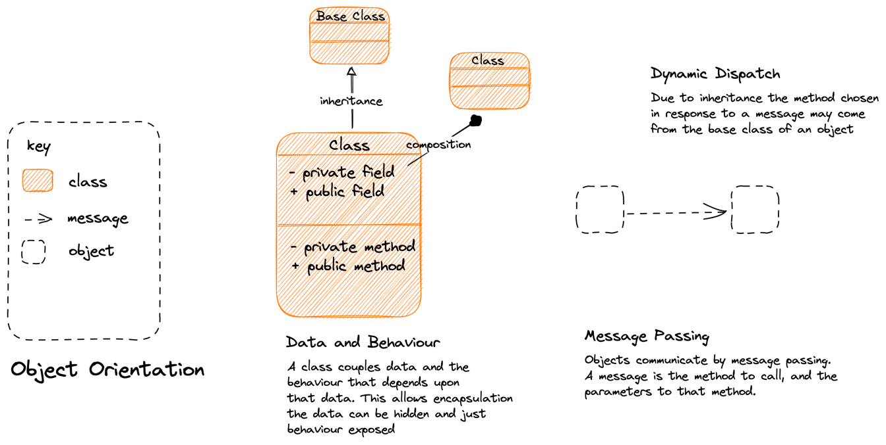
Notes:
Object Orientation
==============
A class has a role, with attendant responsibilities
We capture those responsibilities as behaviors
We encapsulate the data that those behaviors need within the object
Roles may be inherited via dynamic dispatch.

Slide 91
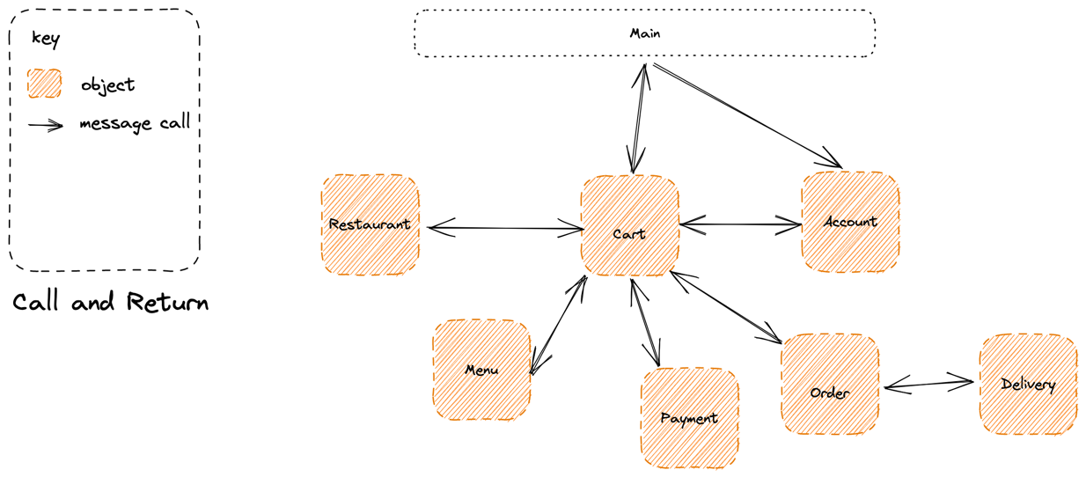
Call and Return: The main method represents our entry point and it uses message passing to invoke objects, which in turn invoke other objects, and return to their caller
God Object: A danger here is that we end up with a ”god” object, such as Cart here, that controls all the other objects. This is a high-degree of behavioral coupling
Notes:
A system passes control to meet a use case between different classes with roles in the system, via message passing
This is a “call and return” approach i.e. main on down

Slide 92
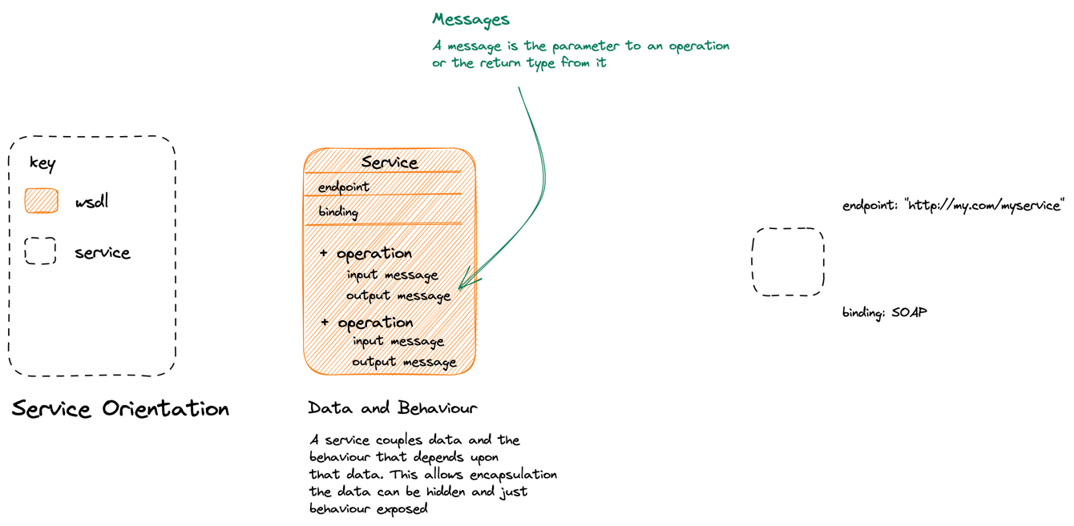
SOA & OO: SOA creates OO-like components, they encapsulate their data and expose behavior that is coupled to that data. This is the Web Services approach to services.
Notes:
SOA
====
SOA takes the idea of objects and uses it a macro scale
- A service has a role in the system, and attendant responsibilities which it exposes via various operations/behaviors.
- The service encapsulates the data that it is associated with those behaviors
- This is OO as an architectural principle.

Slide 93
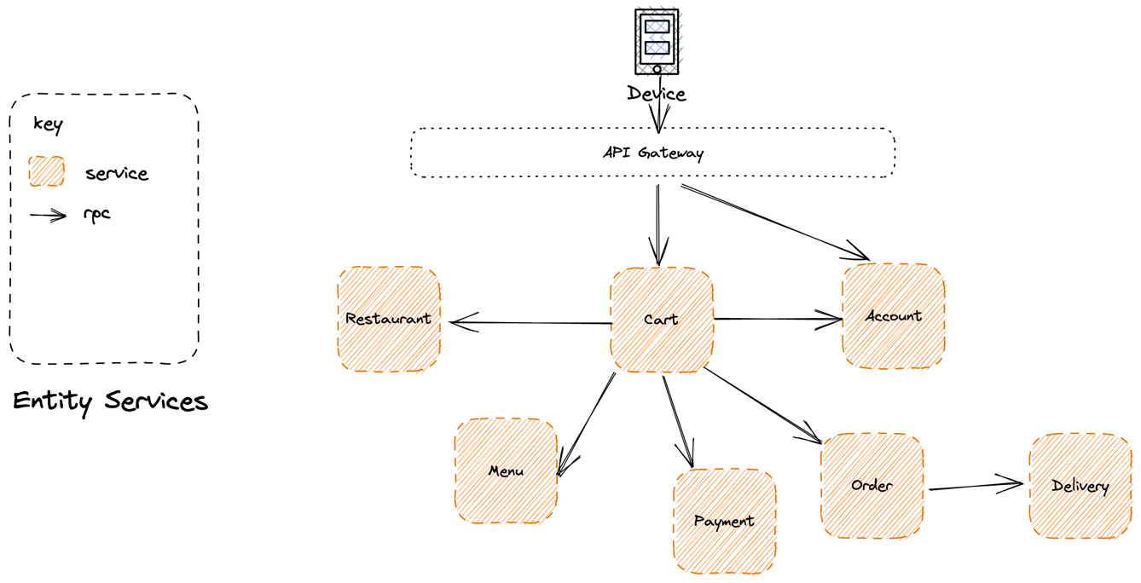
Feature Envy: Because domain logic needs to co-ordinate across these resources, it ends up either on the client, the API Gateway, or the Cart service and not in individual services. An anti-pattern.
SOA & OO: We expose significant resources and operations that you can perform upon them, often CRUD.
Notes:
Because we are making OO large, we have a tendency to use ”call and return” via a main method at our API gateway.
The problem with this is that we are effectively creating a distributed monolith because we are driving from our main method – the gateway.
Is there a better paradigm??

Slide 94
RPC is a synchronous conversation – both parties need to be active during the call
Faults Propagate: With a synchronous service, a fault propagates
Notes:
Typically we use RPC to replace the method calls, which tends to make us brittle as failure propogates

Slide 95
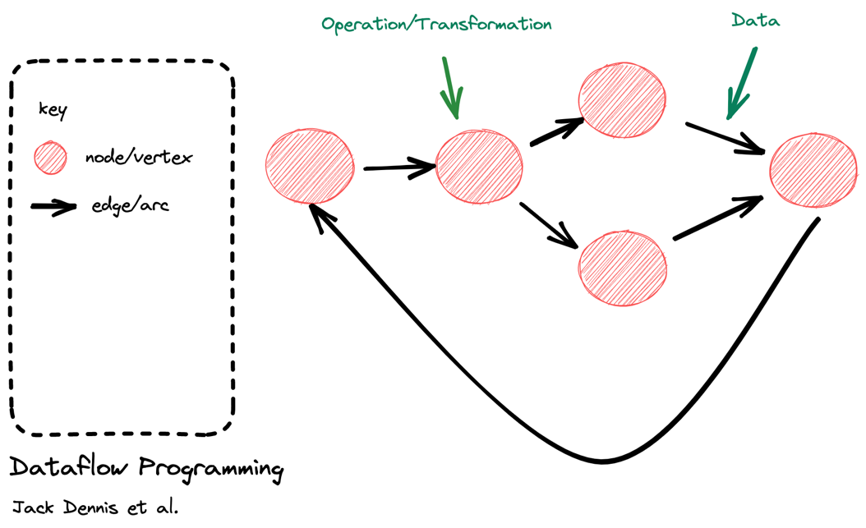
Data Flow Programming conceptualizes a program as a directed graph where operations are represented as nodes which are connected via arcs through which data flows. A node performs an operation when input data is available.
Notes:
Dataflow programming perhaps oldest expression of reactive approach.
Unlike OO where state is co-located in nodes with the behavior that acts upon that state, in dataflow programming data moves between transformations (nodes) via arcs (links).
Example: Unix CLI programming, pipes and filters etc.

Slide 96
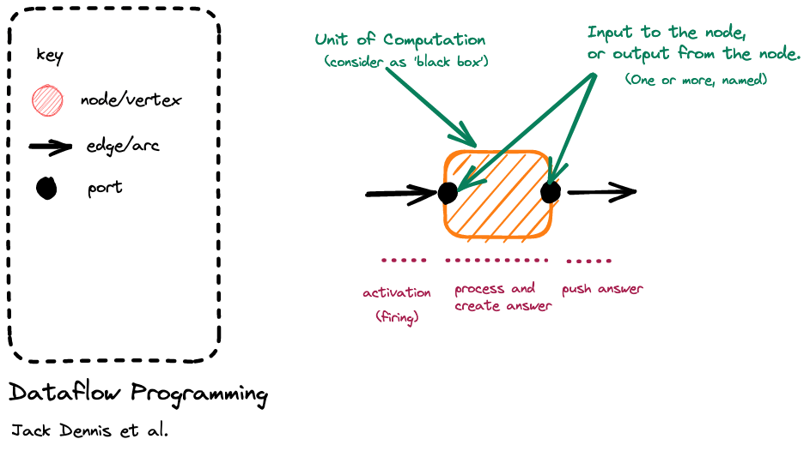
Notes:
Breaking it down, we have a node with an input port, it is activated or fired when an event arrives on the input port arc; it responds to that event with some computation; as it is a ’black box’ it signals what happened by raising an event on an output port (to which others may react)
It is reactive because it fires up in response to an event being raised
Generally a node is single threaded.

Slide 97
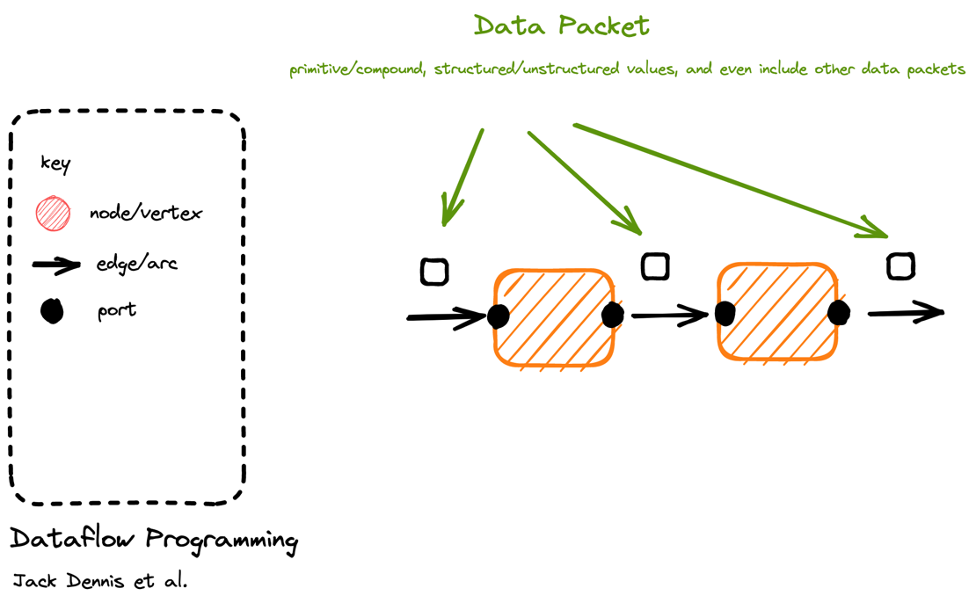
Notes:
No special requirements about packets, they are just data

Slide 98
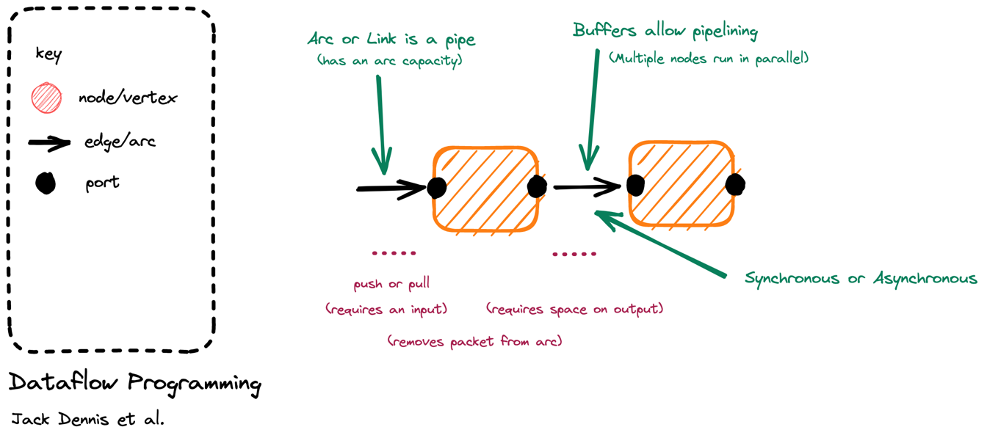
Node Lifetime: In ‘classic’ dataflow programming the lifetime of a node is from activation when there is work to do (push) or work is requested (pull) until it has pushed the answer.
Capacity: In dataflow programming we do not activate a node to read from the input, if there is no space on the output. (Infinite capacity links exist only in theory). This creates backpressure.
Notes:
Arc or links connect nodes
If the link is buffered it means that we can be asynchronous – raise our output event on to the buffer even if the downstream component is currently reacting to an earlier event. This allows us to parallelize, though throughput is limited to the slowest node
But for dataflow this is not a requirement, we may build a synchronous pipeline that has no buffering between components i.e. is single threaded
May be push => source is generating events (hot) like a mouse click and we ‘listen’ to them
May be pull => until we ask for events, by firing up a sink that pulls the chain of nodes, nothing is generated
If a buffer is full, we can’t output to it => this creates backpressure or load shedding

Slide 99
The Reactive Manifesto
Published in September 2014
Author(s): Jonas Bonér (Erik Meijer, Martin Odersky, Greg Young, Martin Thompson, Roland Kuhn, James Ward and Guillaume Bort)
Defines an architectural style: Reactive Applications
Write applications that:
react to events: their event-driven nature enables the following qualities
react to load: focus on scalability rather than single-user performance
react to failure: resilient systems with the ability to recover at all levels
react to users: combine the above for an interactive user experience
Responsive: The system responds in a timely manner.
Resilient: The system stays responsive in the presence of failure.
Elastic: The system stays responsive under varying workload.
Message Driven: Rely on asynchronous message passing
https://www.reactivemanifesto.org/
Notes:
Not just the actor model!!! These ideas have seen expression beyond the actor model, and we would rather follow Helland in noting that many implementations are possible, including the actor model and we will talk about a few of them

Slide 100
Value
Responsive
Form
Elastic
Resilient
Means
Message Driven

Slide 101
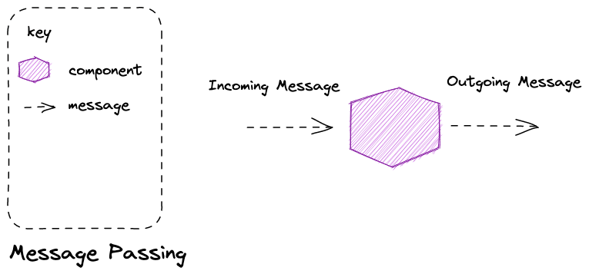
Message Passing is an asynchronous method of communication – both parties do not have to be simultaneously present for communication to occur, instead mail is delivered to ‘mailbox’ of some form for later retrieval.
Notes:
Message passing is a technique for invoking behavior (i.e., running a program) on a computer. In contrast to the traditional technique of calling a program by name, message passing uses an object model to distinguish the general function from the specific implementations. The invoking program sends a message and relies on the object to select and execute the appropriate code. The justifications for using an intermediate layer essentially falls into two categories: encapsulation and distribution.

Slide 102
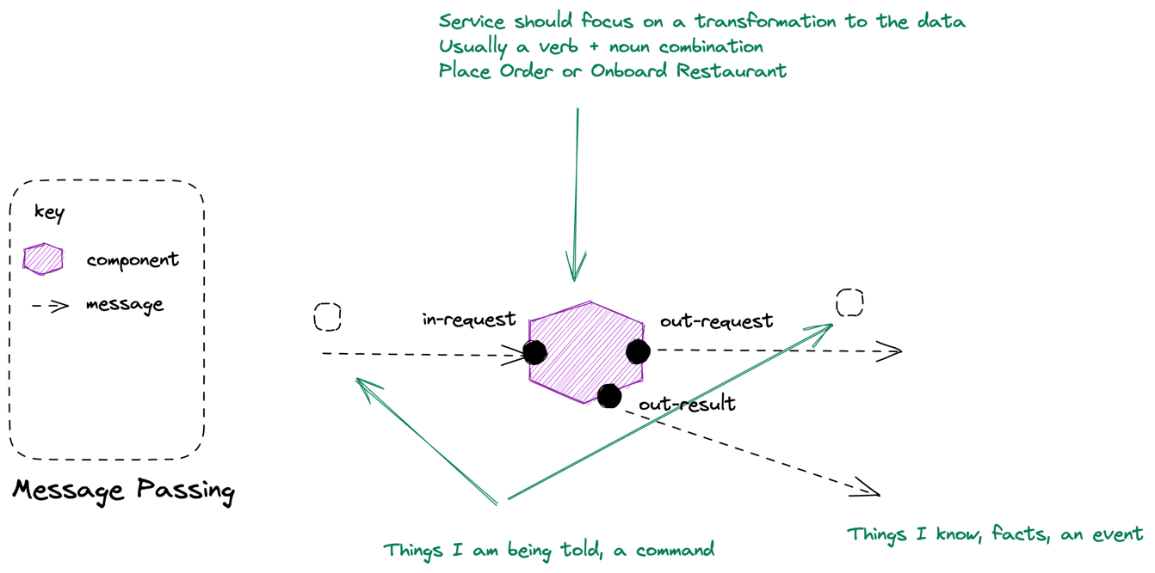
Notes:
Microservices are Reactive Architectures
===============================
Reactive Architectures derive from reactive programming not OO. “Everything flows”
Message passing is a technique for invoking behavior (i.e., running a program) on a computer. In contrast to the traditional technique of calling a program by name, message passing uses an object model to distinguish the general function from the specific implementations. The invoking program sends a message and relies on the object to select and execute the appropriate code. The justifications for using an intermediate layer essentially falls into two categories: encapsulation and distribution.
You can see how this means we are working in the reactive style: we separate data from behavior and activate a component in response to work being on a queue, process it, and then send an outgoing message

Slide 103
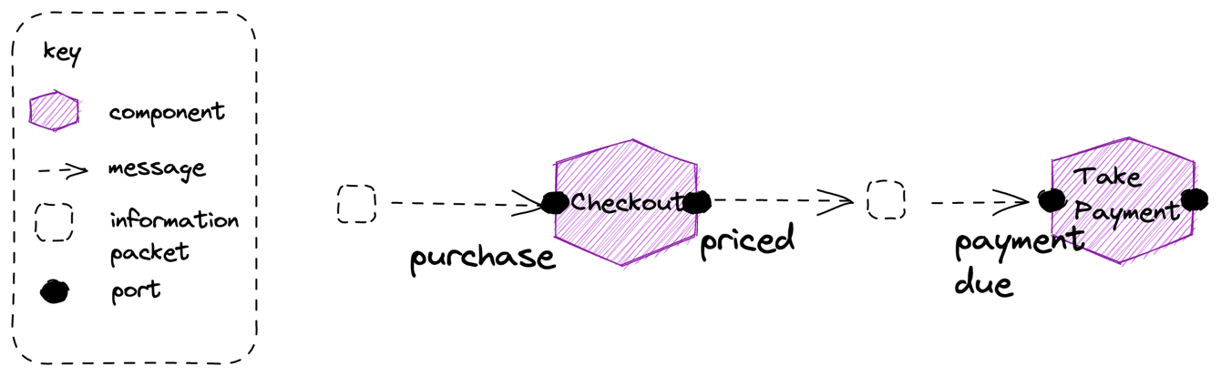
Coordinate Dataflow A reactive principle where we “orchestrate a continuous steady flow of information” focusing on division by behavior, not structure
Partitioning Partition to take advantage of parallelism in the system, tasks that could be done concurrently with each other
Notes:
Dataflow Reactive architectures inherit from dataflow programming – we conceive of our application as a graph of nodes that perform operations on data flowing through the system
Reactive shines in the creation of data-driven applications through the composition of components in workflows. Thinking in terms of dataflow, how the data flows through the system, what behavior it is triggering and where, and how components are causally related allows focusing on the behavior instead of the only on the structure. Orchestrate workflow and integration by letting components (or subsystems) subscribe to each other’s event streams, consuming on-demand the asynchronously published facts.

Slide 104
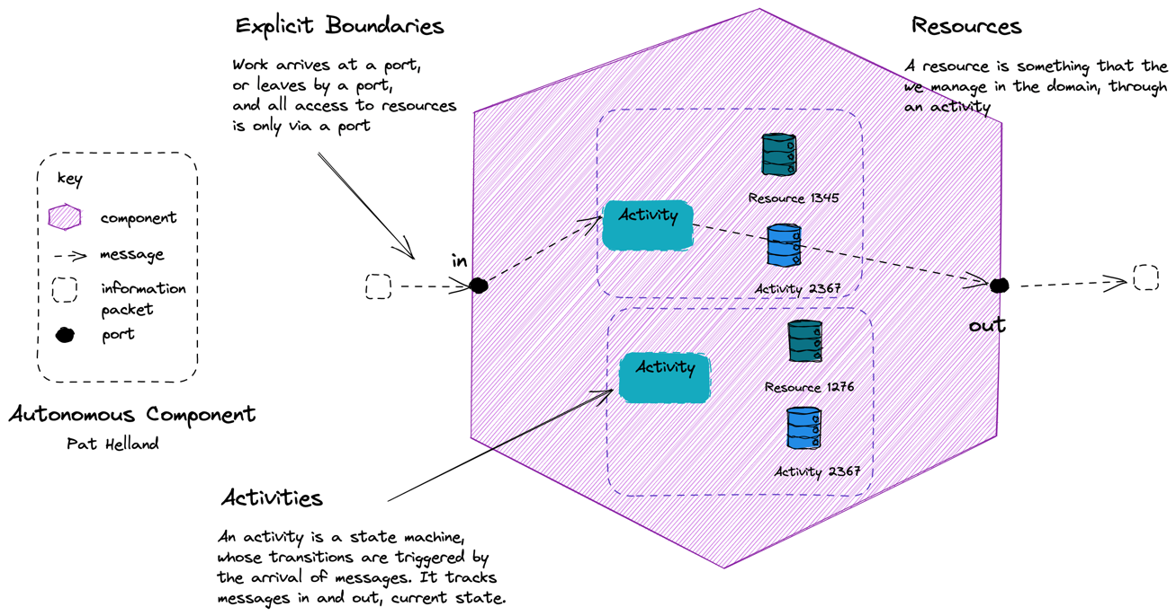
Isolate Mutations A reactive pattern where we “contain and isolate mutable state”. The mutable state lives within a component that has a defined boundary.
Assert Autonomy A reactive principle where we “by clearly defining the component boundaries, who owns what data and how the owners make it available”
Notes:
Assert Autonomy: Design components that act independently and interact collaboratively. In Reactive applications, autonomy is achieved by clearly defining the component boundaries, who owns what data and how the owners make it available, and by designing them such that each party is afforded the necessary degree of freedom to make its own decisions.
Actors are ONE option: although actor frameworks are one option, reactive applications like this can use many implementation approaches

Slide 105
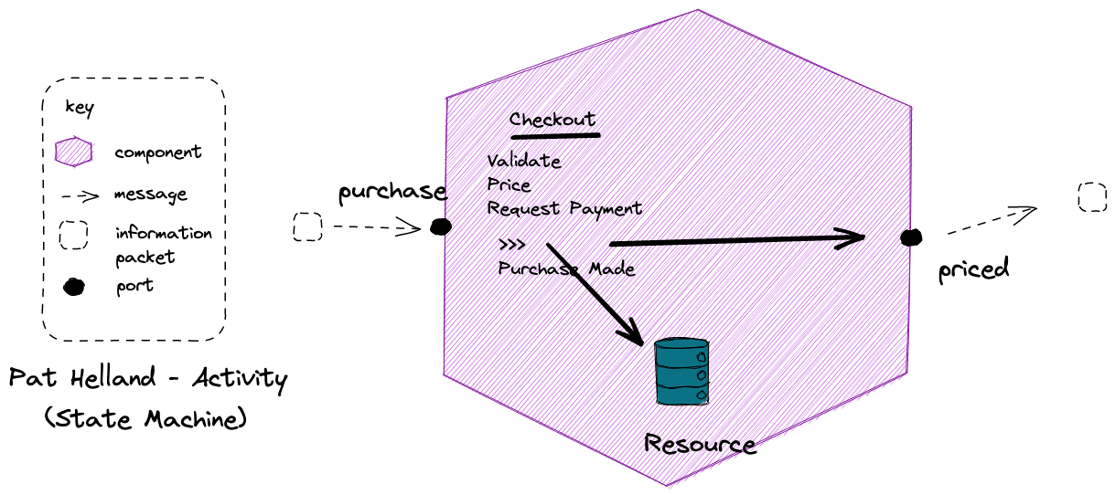
Notes:
Resource might be something like vouchers here; once you have used a voucher code for a discount, it can’t be reused by that customer

Slide 106
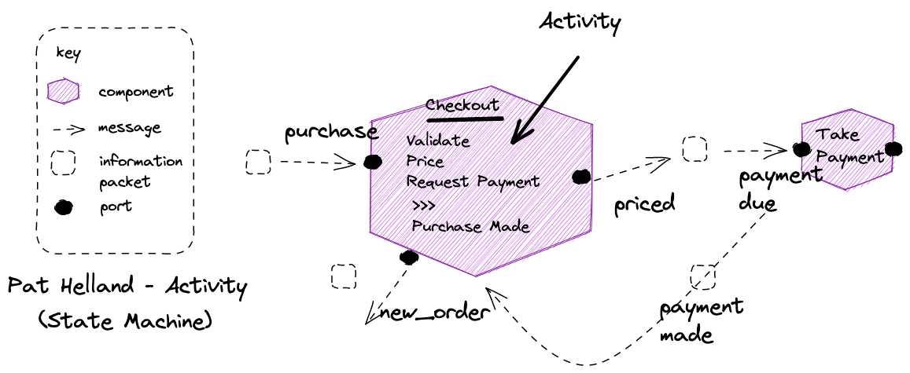
Notes:
No need to block for request-response, we get a reply via a message too

Slide 107
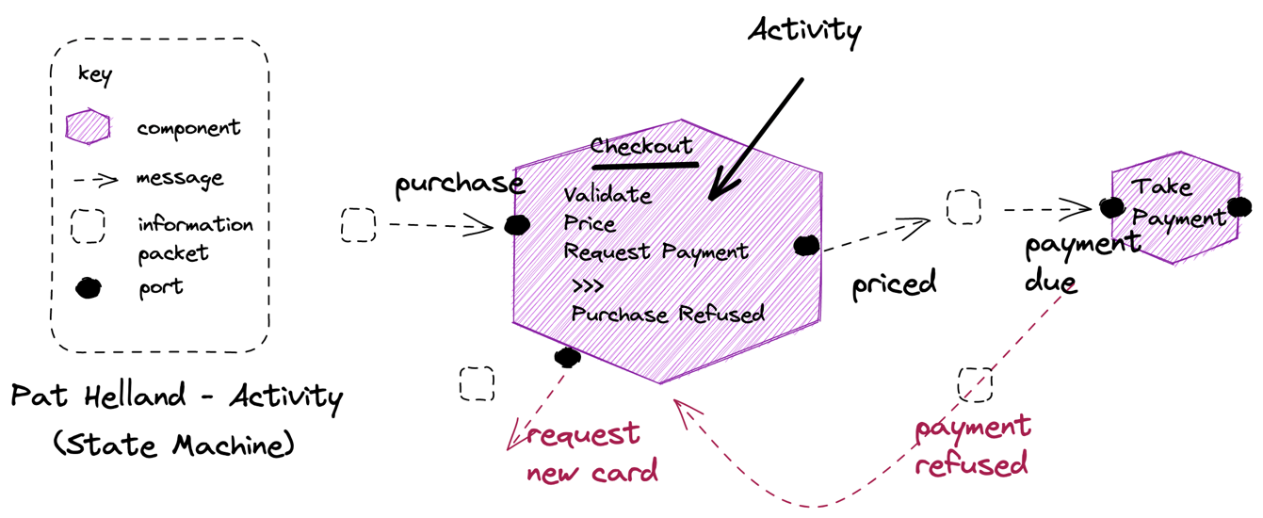
Notes:
Unhappy paths are also messages, just a different message, usually to a different port

Slide 108
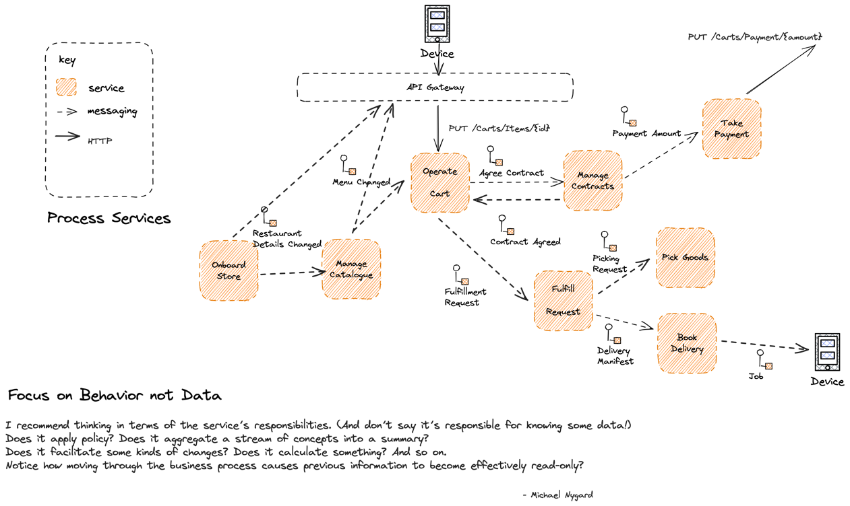

Slide 109
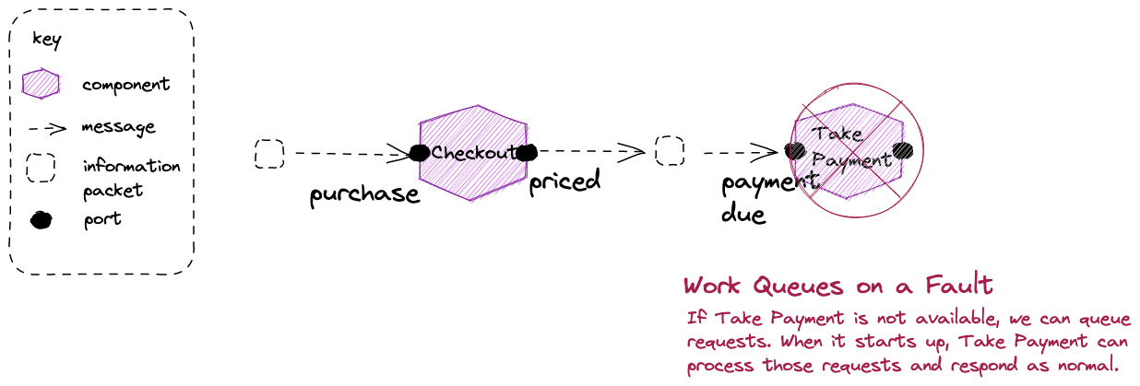
Bulkheads: In an asynchronous conversation a fault does not propagate back up the chain – we have a bulkhead that protects us against failure
Notes:
With asynchronous message passing the receiving object can be down or busy when the requesting object sends the message. Continuing the function call analogy, it is like a function call that returns immediately, without waiting for the called function to complete. Messages are sent to a queue where they are stored until the receiving process requests them. The receiving process processes its messages and sends results to a queue for pickup by the original process (or some designated next process).^{[3]}
Asynchronous messaging requires additional capabilities for storing and retransmitting data for systems that may not run concurrently, and are generally handled by an intermediary level of software (often called middleware); a common type being Message-oriented middleware (MOM).

Slide 110
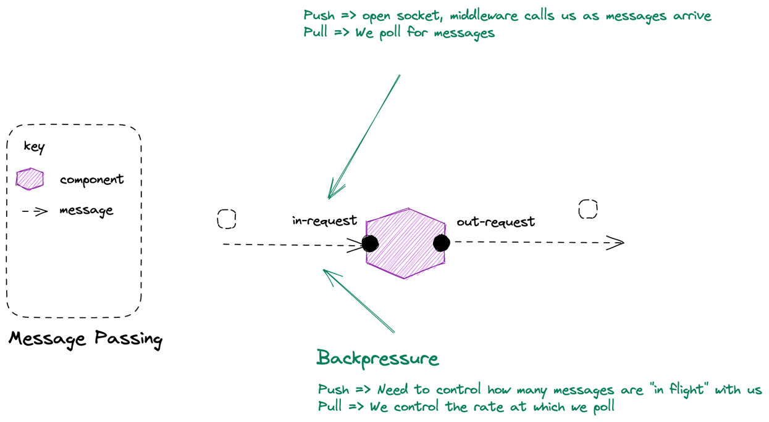
Blocking Retry: Blocking Retry – when we keep trying to process a message, such as when we cannot connect to a DB and retry, creates backpressure as we slow consumption.
Notes:
Back-Pressure and Load-Shedding
If you have no buffers, or your buffers are full then something has to be sacrificed. Either we need to slow down the producer (back-pressure) or we need to discard data (load-shedding).
Back-pressure is the concept of the producer getting backwards pressure from the pipe it shoves data down, forcing it to slow down until the pressure alleviates. Back pressure is a good option when data loss is unacceptable and the extra latency is not an issue.

Slide 111
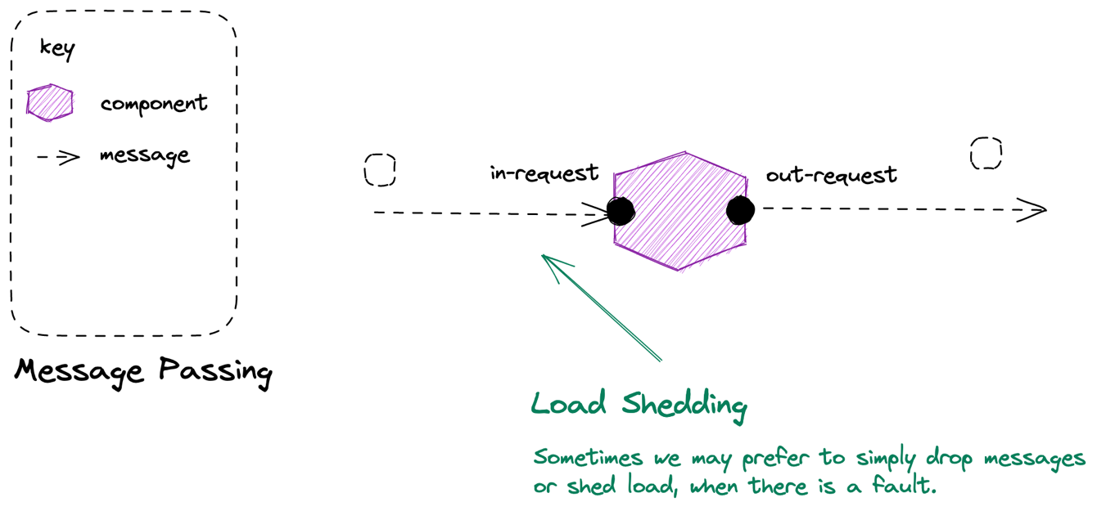
Notes:
Back-Pressure and Load-Shedding
If you have no buffers, or your buffers are full then something has to be sacrificed. Either we need to slow down the producer (back-pressure) or we need to discard data (load-shedding).
Load-shedding means we discard data in order to keep up. This can be a great option for metrics that are published at high velocity. We might receive a metric at a 1000 updates per second, but only need 10 per second in order to meet our SLA. We can even prioritize our load-shedding intelligently so we only discard less valuable data.

Slide 112
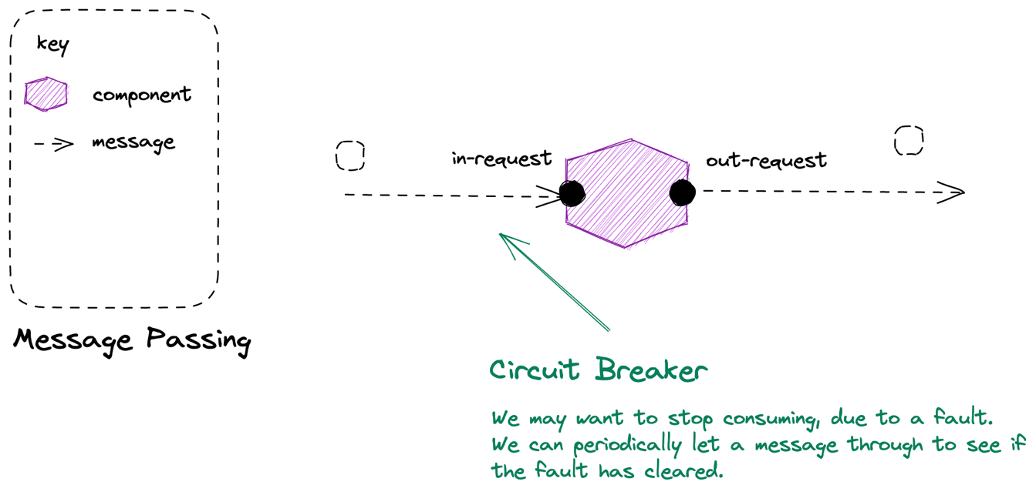

Slide 113
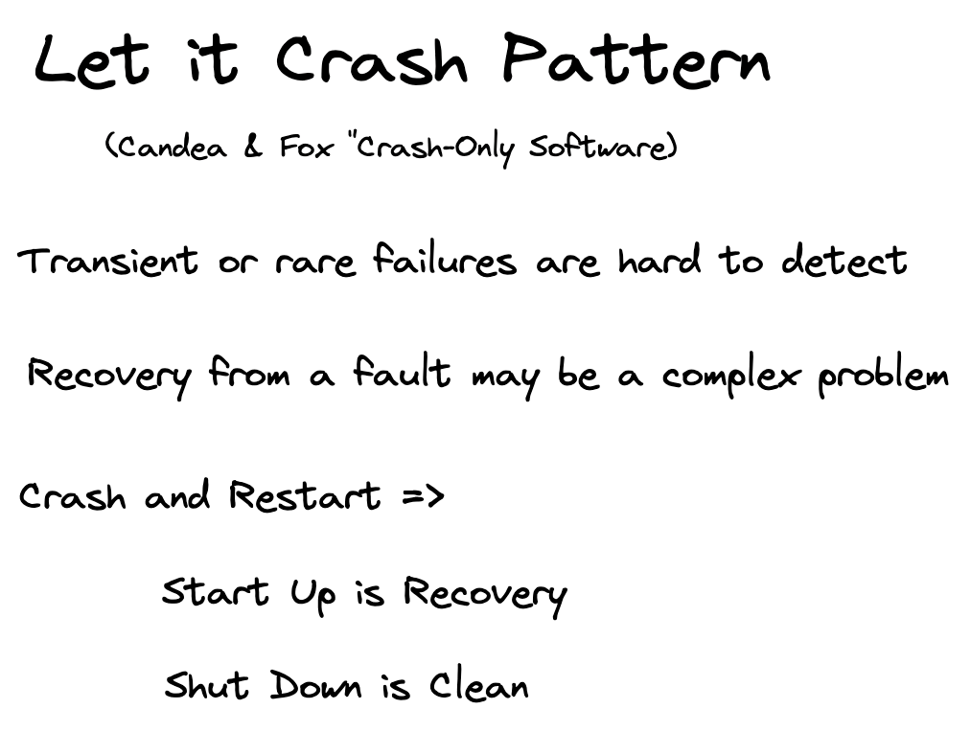

Slide 114
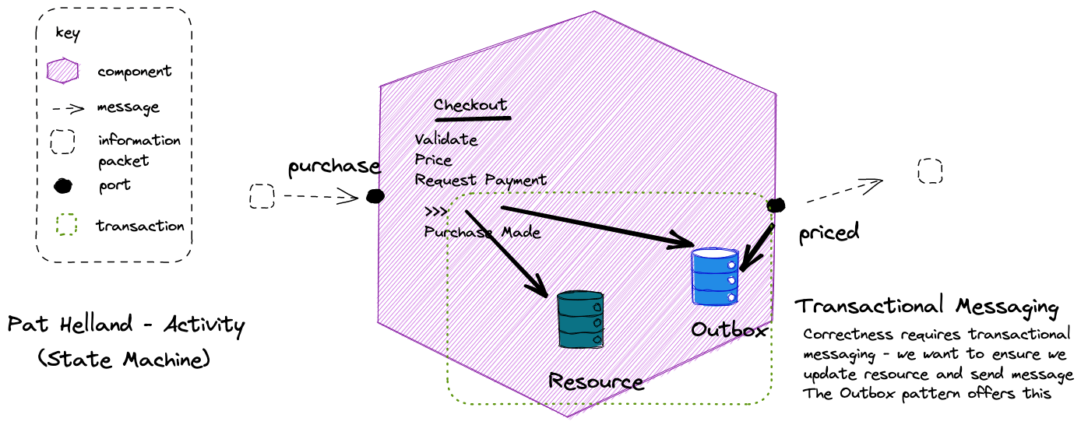

Slide 115
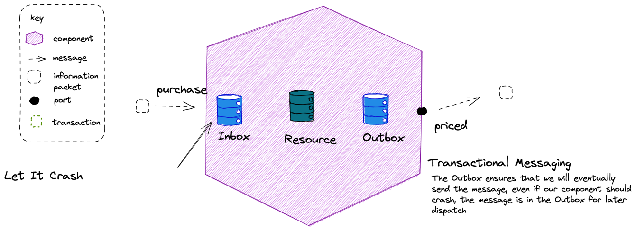

Slide 116
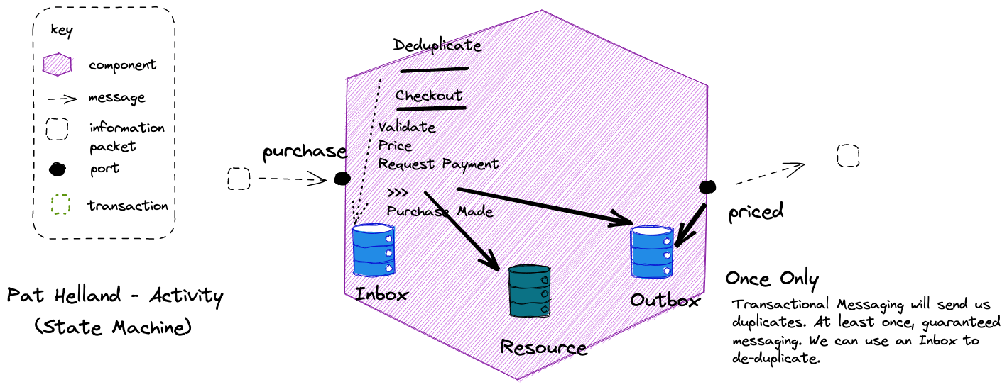

Slide 117
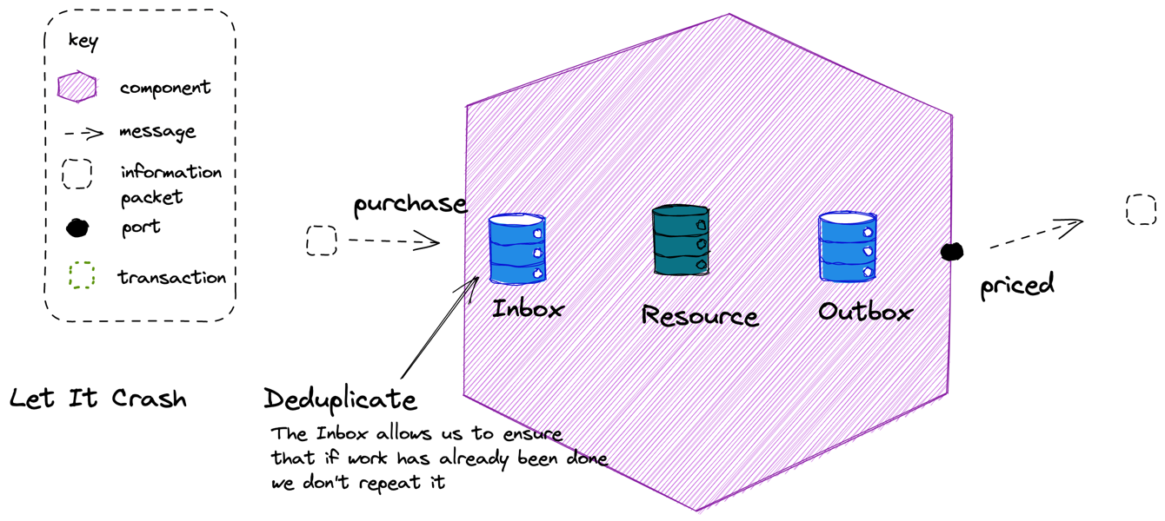

Slide 118
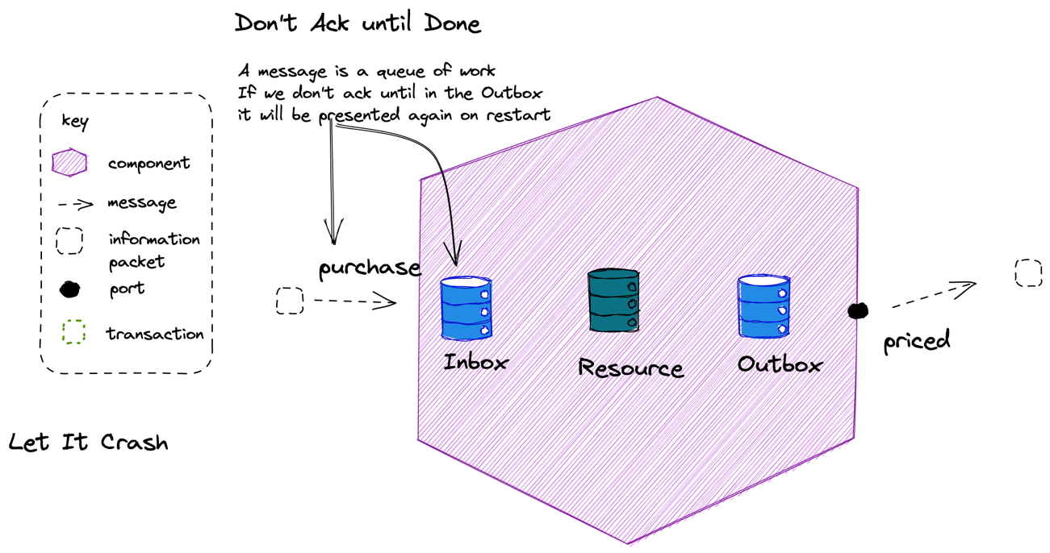

Slide 119
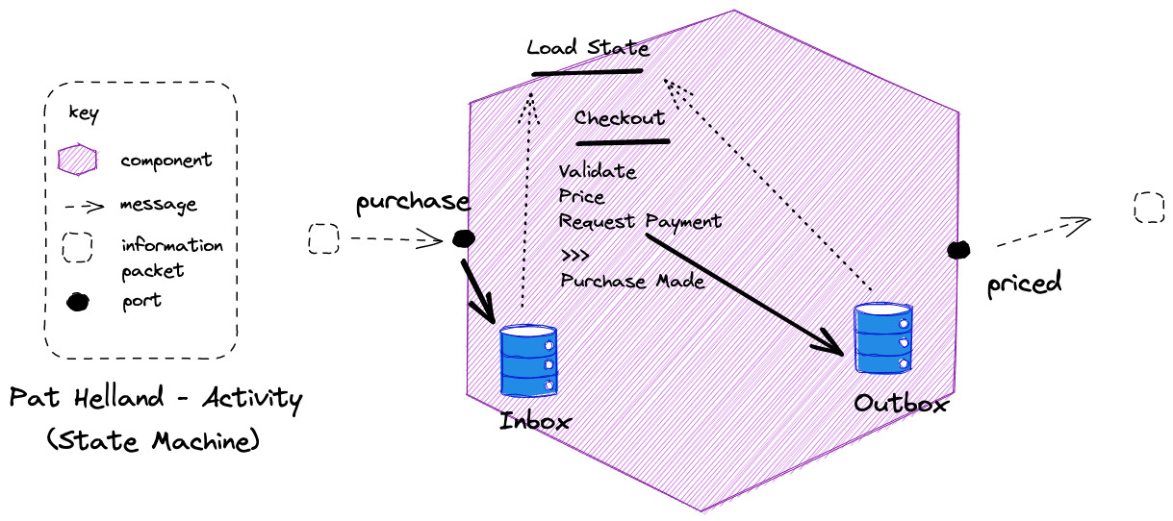
It is possible to calculate activity state by comparing the inbox and outbox to determine where a flow reached, in the event of failure, over storing current state.

Slide 120
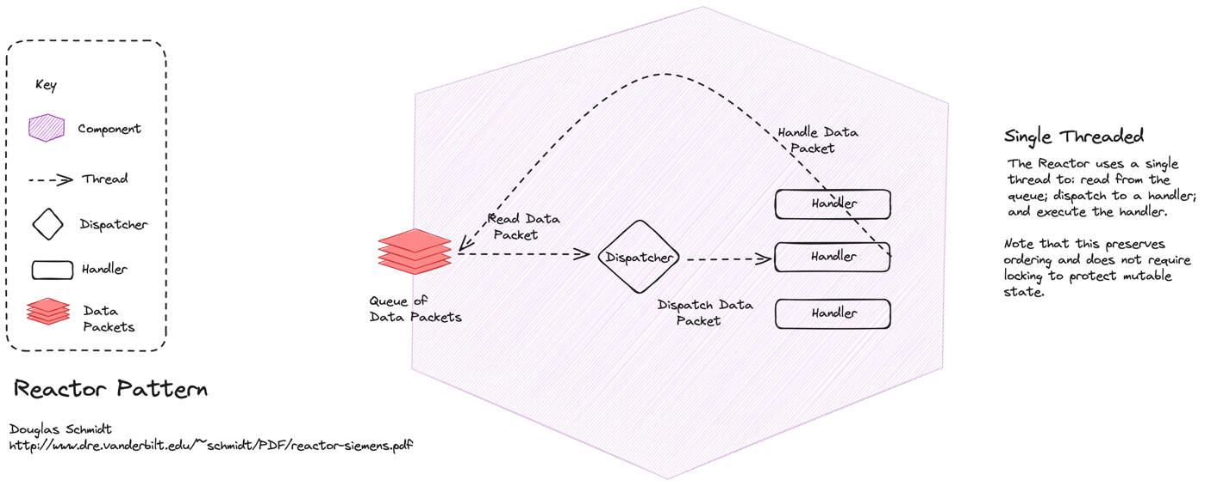

Slide 121
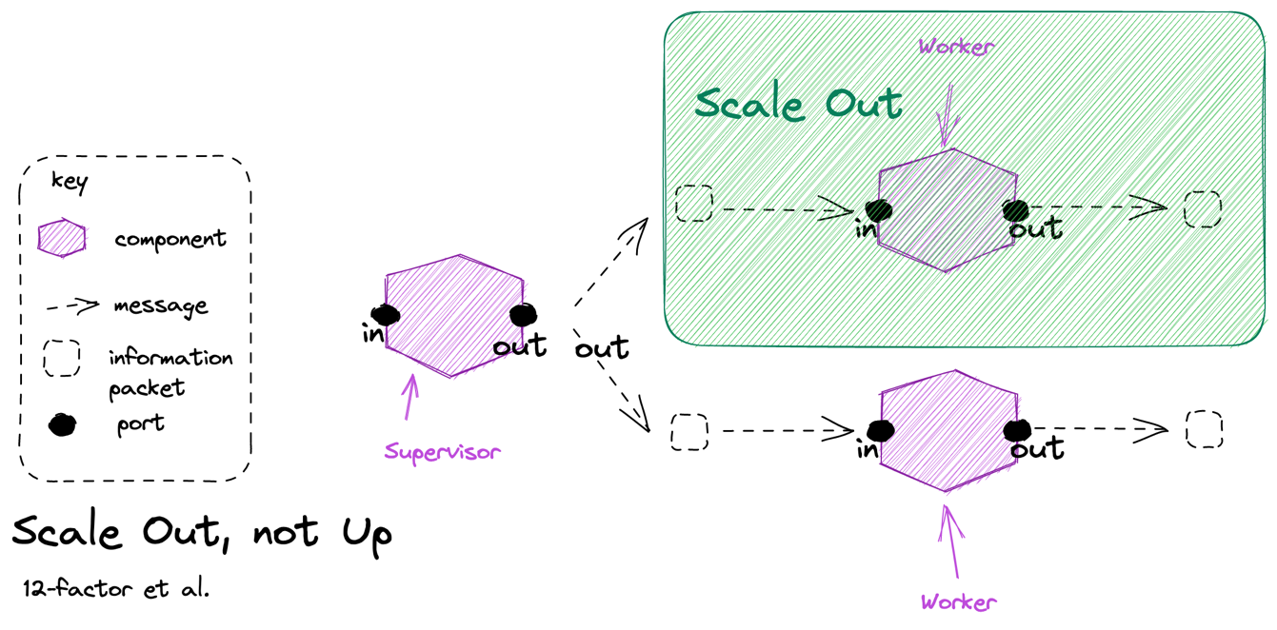

Slide 122
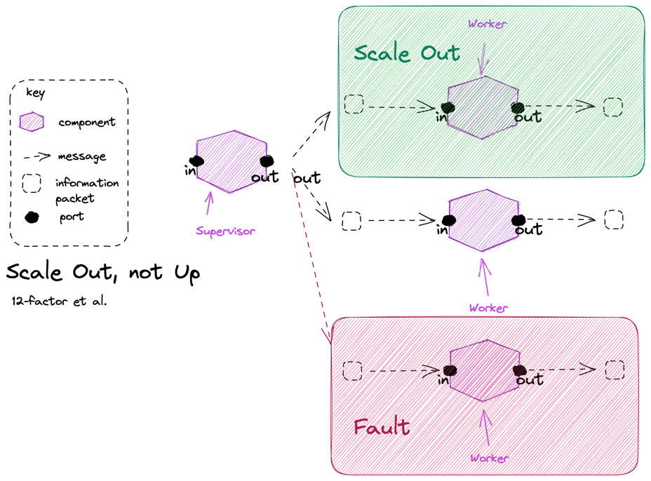

Slide 123
Paper Workflows
“My life looked good on paper - where, in fact, almost all of it was being lived.” - Martin Amis

Slide 124
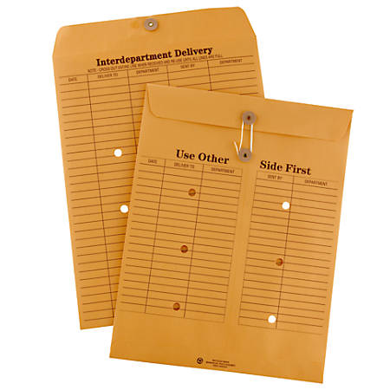

Messaging/Discrete Event
Series Event (Document)
Discrete, Immediately Actioned
Series, Supports Action
Skinny
Fat

Slide 125

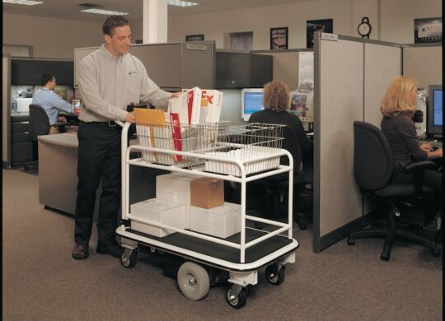

Slide 126
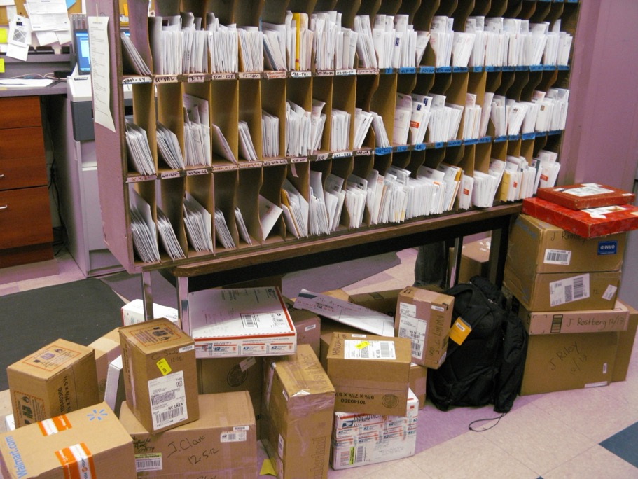
Notes:
When I worked in a mail room, this was called ‘the frame’ and it was how we sorted mail by floor, that was then delivered by a worker with a cart. In essence this is what a broker does. Creates channels, that you send messages to that are delivered to subscribers.

Slide 127
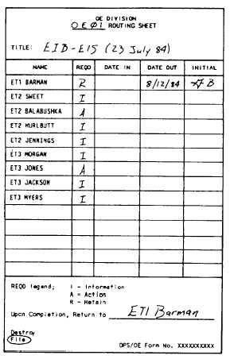

Slide 128
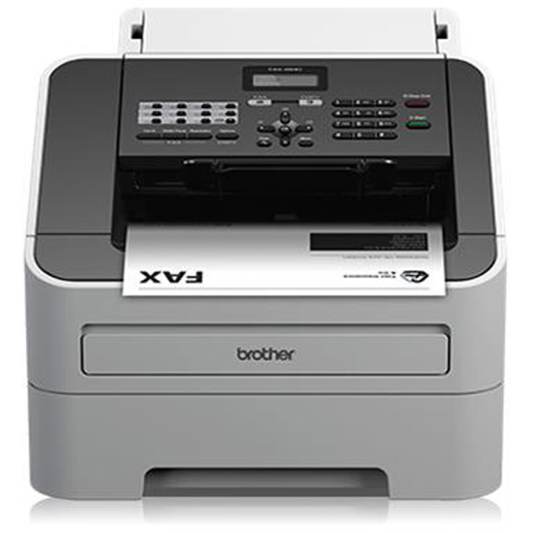

Slide 129
What is a microservice?
SOA is focused on business processes. These processes are performed in different steps (also called activities or tasks) on different systems. The primary goal of a service is to represent a “natural” step of business functionality. That is, according to the domain for which it’s provided, a service should represent a self-contained functionality that corresponds to a real-world business activity.
Josuttis, Nicolai M.. SOA in Practice: The Art of Distributed System Design . O'Reilly Media. Kindle Edition.
Notes:
Whilst this is SOA advice, we are taking the view that microservices are just SOA 3.0, and as such, most of the best practice still applies
The key here is to understand that we want service alignment with a business process or activity. Whilst services offer us benefits such as fault-tolerance through isolation, that is not the thrust of this workstream. Instead this workstream is looking at how microservices improve our productivity, when we get alignment between a service and a business process.
We amplify this point in the next slide, which talks about the entity service anti-pattern

Slide 130
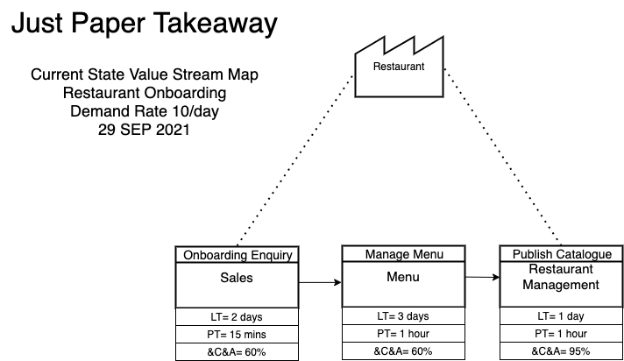

Slide 131
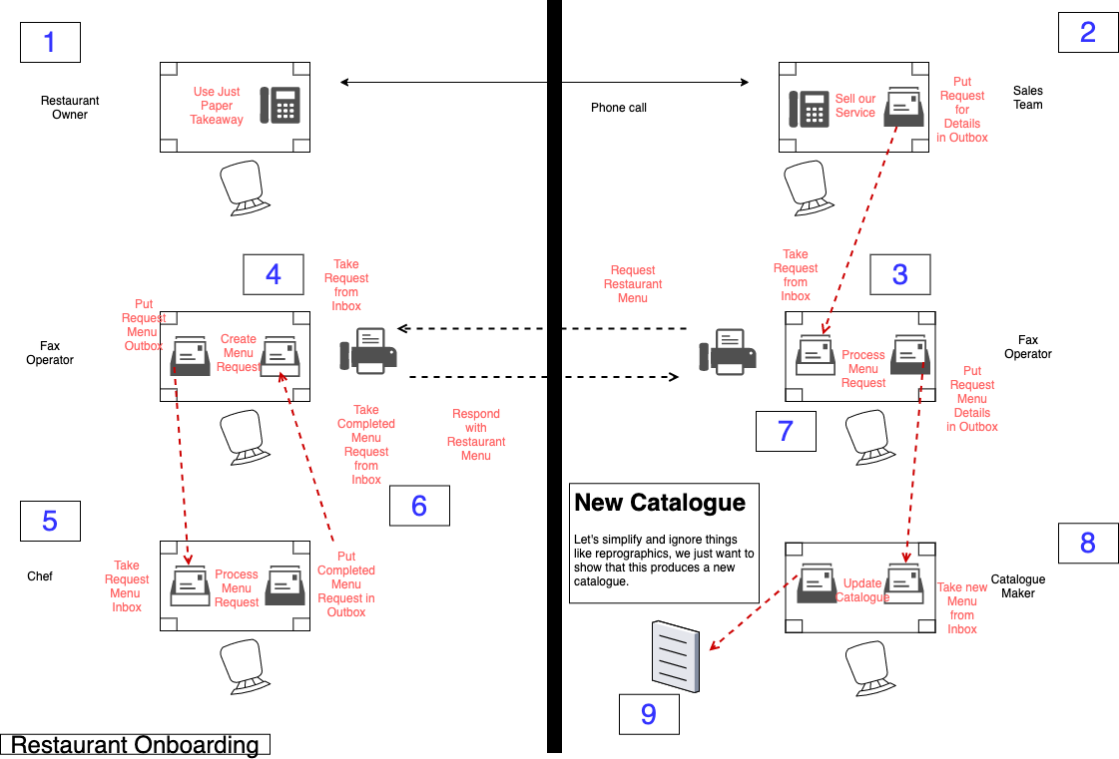

Slide 132
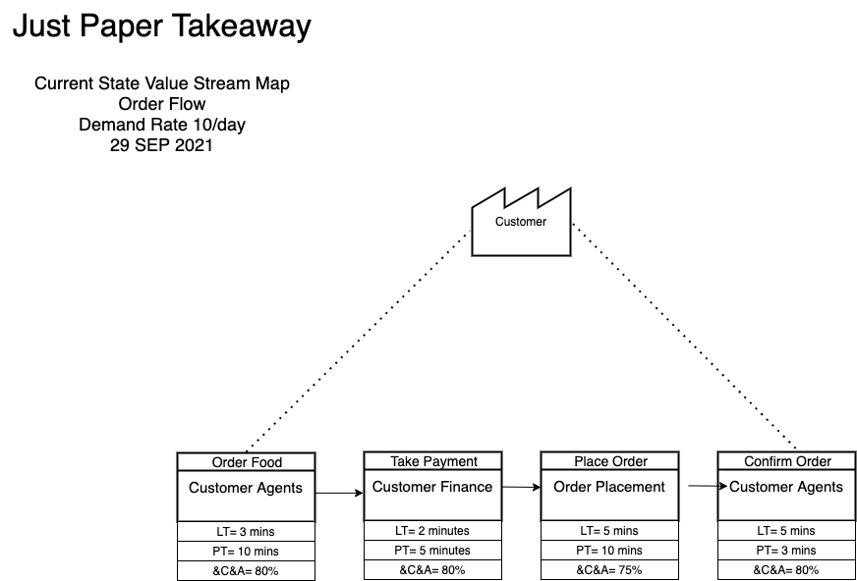

Slide 133
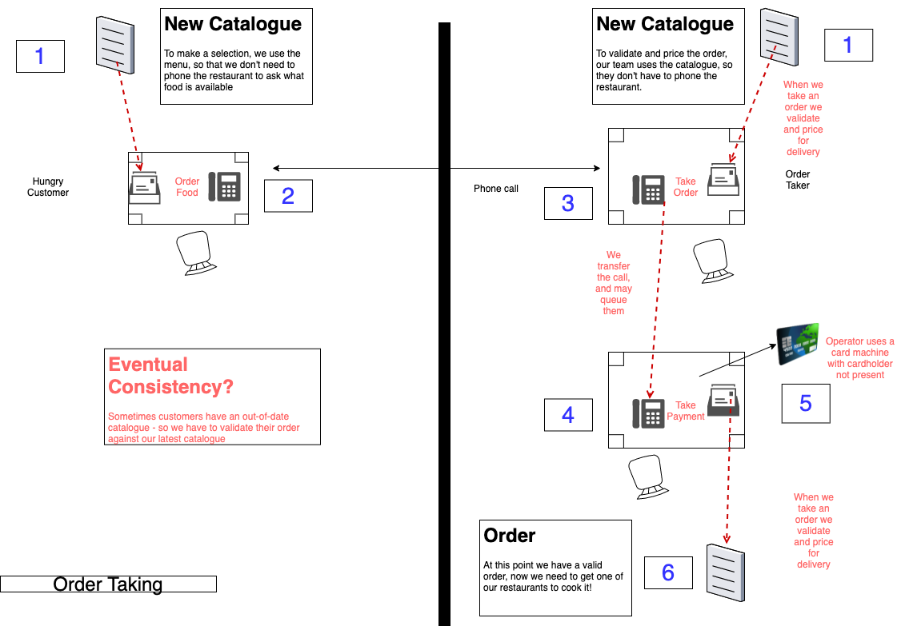

Slide 134

Order Wheel
Notes:
In a restaurant an order wheel is a piece of equipment used to track customer orders. It is used to facilitate a process whereby a new order is clipped onto a wheel which is then turned clockwise from the server or "waitress" side of the restaurant around to the kitchen or "cook" side. Orders are made in sequence and turned further back around to the server as completed.

Slide 135
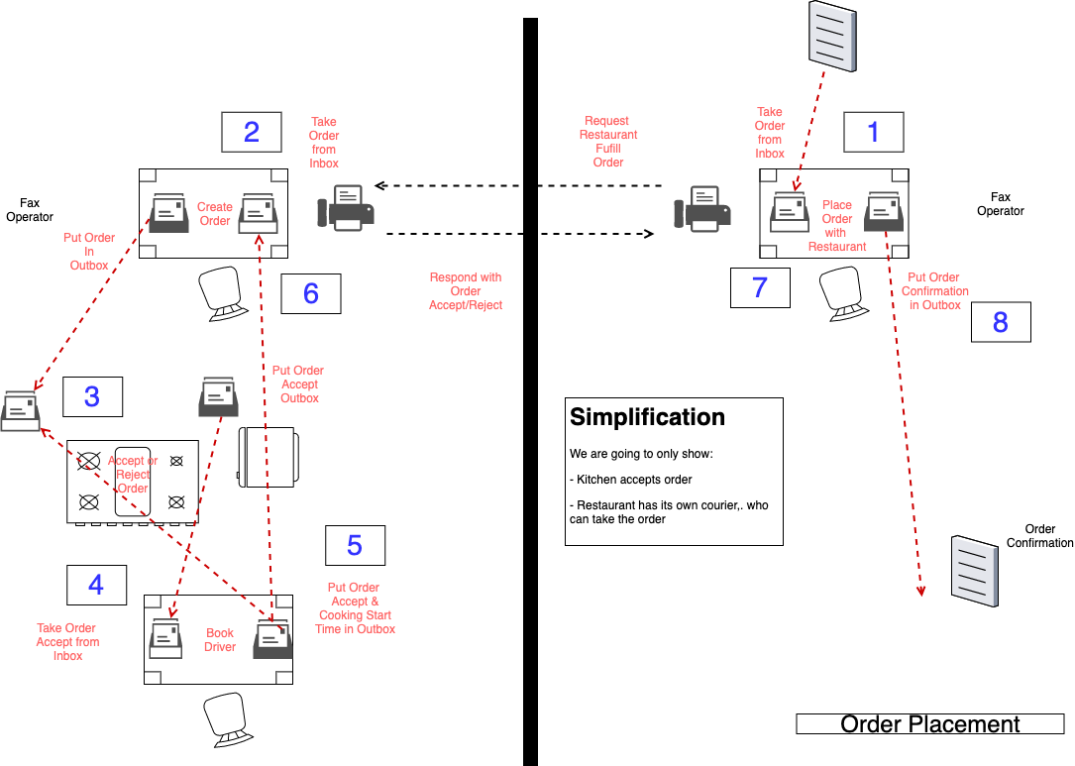

Slide 136
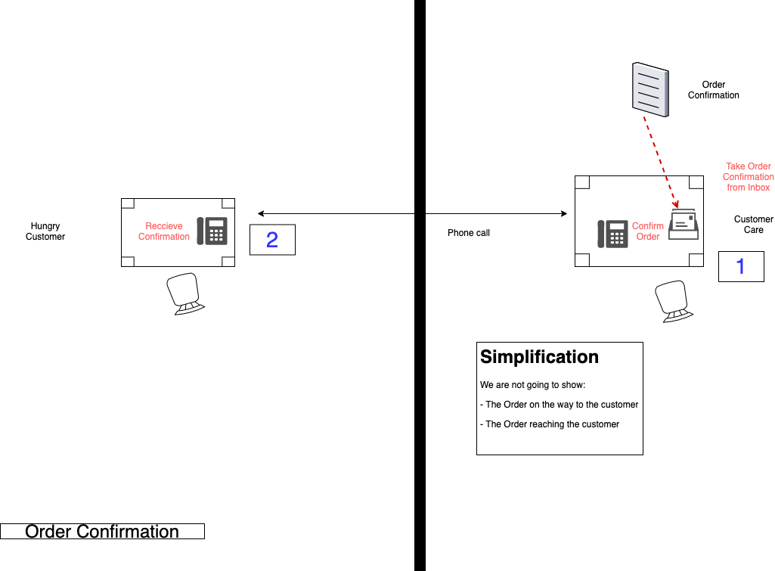

Slide 137
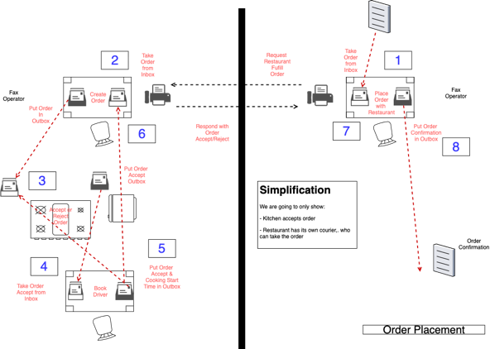
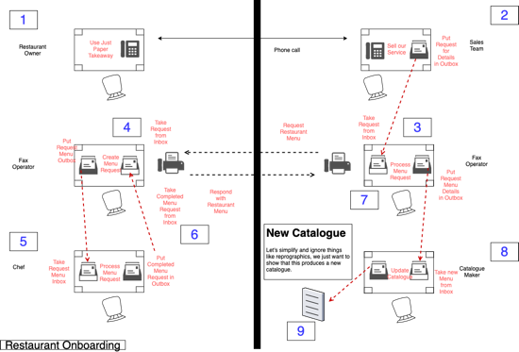
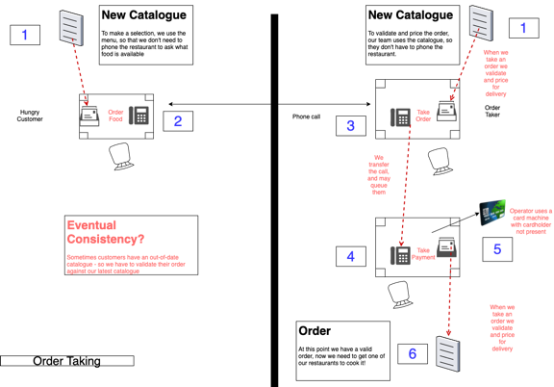
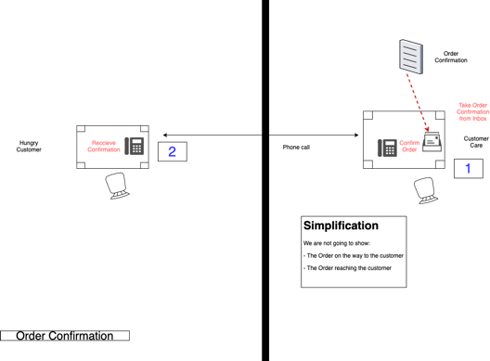

Slide 138
Compensation

Slide 139

Notes:
This is a carbon copy memo – when you write on it, the pressure creates a copy in the carbon paper underneath, it was used to ensure that you had a copy of any message that you sent. You could also look through the message history on a file to understand the current state of a file.

Slide 140


Slide 141

Notes:
How do we deal with errors

Slide 142


Slide 143


Slide 144
Flow Based Programming
“Everything Flows and Nothing Stays.” - Heraclitus

Slide 145

Flow-Based Programming (FBP) is a subclass of DFP. While DFP can be synchronous or asynchronous, FBP is always asynchronous. FBP allows multiple input ports, has bounded buffers and applies back pressure when buffers fill up.

Slide 146

Node Lifetime: In flow base programming the a node can remain running whilst there is work on an input queue, can can suspend instead of terminate if there is no work on its connector.

Slide 147

Notes:
MQTT Retained Messages are a way of emulating this IIP idea.

Slide 148

Capacity: In flow-based programming a component can test to see if it can send to out, and if not decide whether to halt or ignore.

Slide 149


Slide 150

Walk of Shame: The trouble is that we may keep asking, so it makes sense to cache this somehow.

Slide 151


Slide 152


Slide 154

Storage: Request details may need storage to be reliable, it takes work from the request_details port, but cannot forward it to the restaurant_details port without waiting for an answer from fax_in. We store the state of the workflow in case we crash before receiving the response.
in-Only
In-Only
Out-Only
Messaging
Messaging
Eventing
Messaging
Eventing
In-Out
Correlation: To allow us to match the response to the saved state we use a correlation id. We send it on the ip to fax_out, and the restaurant includes it on the ip from fax_in. We use the ip to look up the workflow we stored.

Slide 156

Lookup: We can build a store from IP raised from another component to act as a lookup table for information that we need to process a request.
Eventing
Out-Only
In-Only
In-Only
Messaging
Messaging
Messaging
Eventing
In-Out

Slide 158

Messaging
Message Triggers
Fault
Message Triggers
Fault
Eventing

Slide 160

Message Triggers Fault
in-Out
in-Out
Eventing
Messaging
in-Only
Eventing
Messaging
Messaging
Messaging
in-Out
Eventing
Eventing
Eventing

Slide 162


Slide 163
Exercise material
Paper Flow
Readme
Slides

Slide 164
Next Steps

Slide 165

Further Reading

Slide 166

Further Reading
https://serverlessland.com/event-driven-architecture/visuals

Slide 167
Q&A

